Slide 1
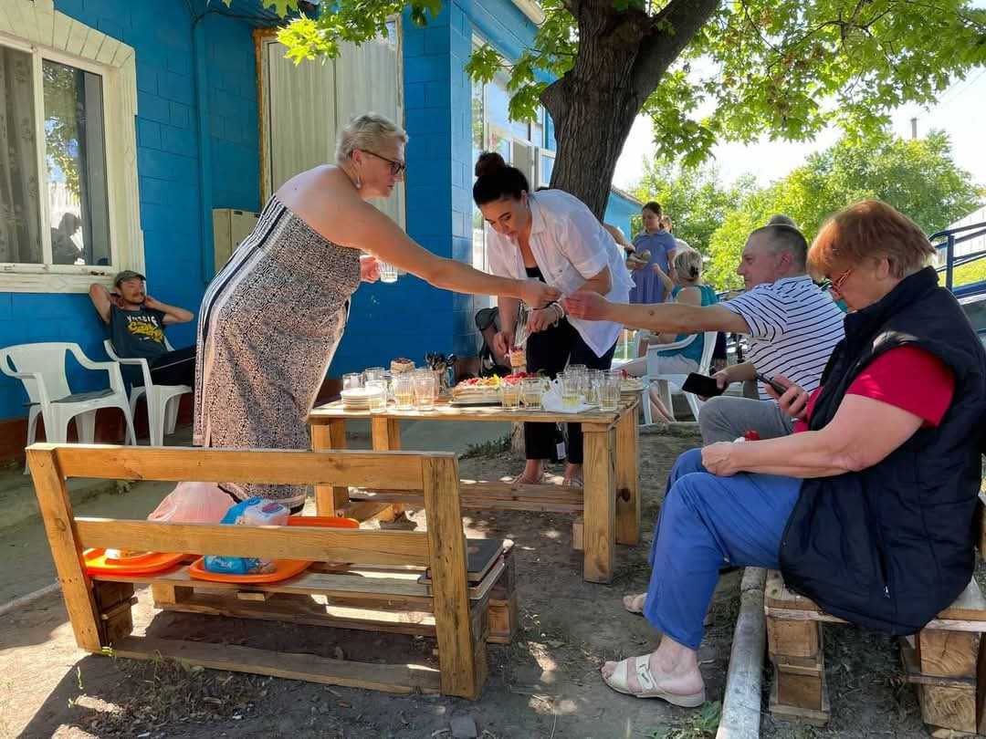
Diaconal actors and crisis preparedness
-some examples and reflections from Deaconess Foundation

Slide 2
Working towards lives in dignity in Finland and globally

Slide 3
the Roma Women's Power Project (Belarus, Moldova, Ukraine) 2019-
Economic empowerment and political participation among Roma women and girls
the Roma Participation (Ukraine) 2019
Political participation and policy work
Refugee centre for for refugees with disability and Roma persons, 2022
Emergency work, policy and advocacy work, 2022

Slide 4
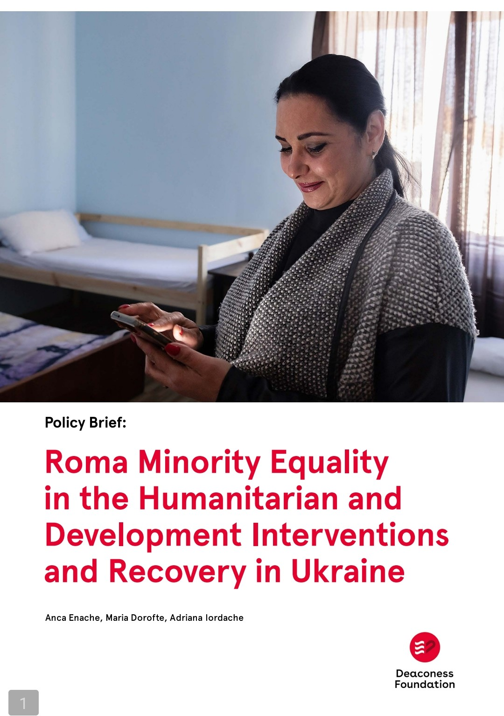
What our emergency work with Roma minority from Ukraine and Roma refugees and refugees with disability taught us about the need for preparedness?

Slide 5
It is important to integrate emergency support in the plans of all our interventions; map the possible emergencies as risks => preparedness?
Persons and communities affected by inequalities, by poverty, by historical forms of oppressions and racism, persons with disabilities and vulnerable health, are affected disproportionately and harsh by disasters, threats and crisis.
The authorities in charge for managing emergencies and crisis support have little or no knowledge about vulnerable communities. They lack established paths to reach and communicate with these communities. These also applies to humanitarian actors and to international organisations sometimes.
Emergency messages are communicated through channels or in languages and vocabularies inaccessible to vulnerable groups.

Slide 6
Vulnerable, oppressed and racialized communities have little trust in the authorities responsible for handling crisis and they might lack knowledge about crisis legislation and support. Facilitating such information is important.
Psychosocial support must be integrated in all crisis’s interventions.
Humanitarian work is a very established and regularized field.
The emergency support must be localized to be effective.
Emergency support is expensive.
The safety of the staff can be under threat. Such risks can be mitigated through trainings and a deep knowledge and analysis of the operational environment.
Individual, collective and societal trust and participation are crucial during the crisis. This must be cultivated before the actual crisis start (preparedness)?
Multi-stakeholder cooperation is crucial during crisis (preparedness) ?

Slide 7
Reflections on Preparedness as Approach/Actions in our Work

Slide 8
The NEXUS approach
What about the interlinkages/ overlaps? between social services/diaconal actions, emergency work and work on social cohesion/participation/good relations between groups?
PEACE
DEVELOPMENT
HUMANITARIAN AID
Social services/social interventions
Social cohesion/Equality work/trauma and psychosocial support
Emergency interventions
Triple nexus: refers to the interlinkages between humanitarian aid, development cooperation and peace action.

Slide 9
The NEXUS approach
Region/ Nation wide
Household
Individual
Community
Global
Social services/social interventions ACTORS
Social cohesion/Equality work/trauma and psychosocial support
ACTORS
Emergency interventions
ACTORS
Map what different actors do.
Develop collaboration, common interventions and preparedness plans?

Slide 10
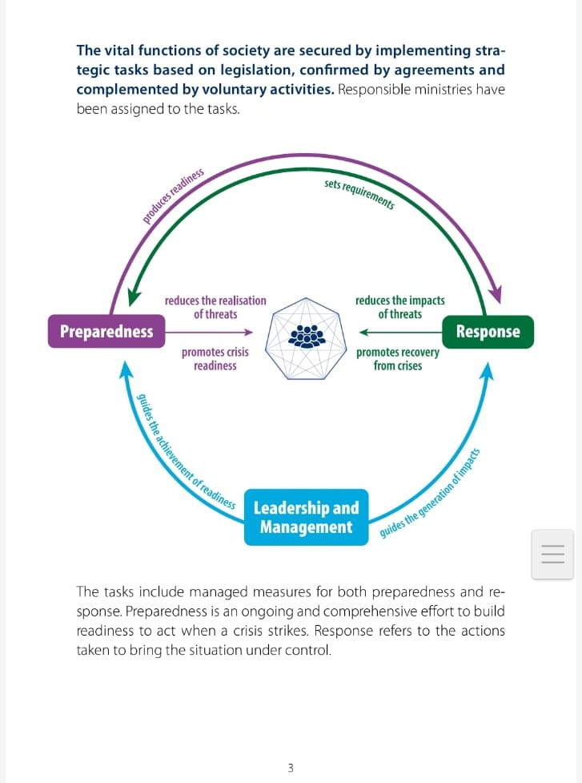
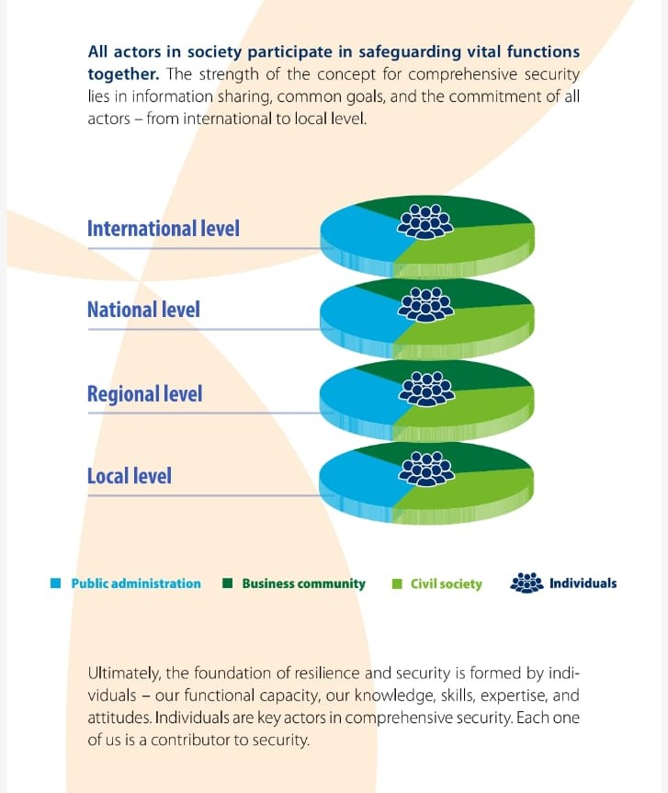
The Finnish Preparedness Cooperation Model, Comprehensive Security
The Security Strategy for Society, Government resolution, Security Committee. Publications of the Finnish Government, 2025:3.

Slide 11
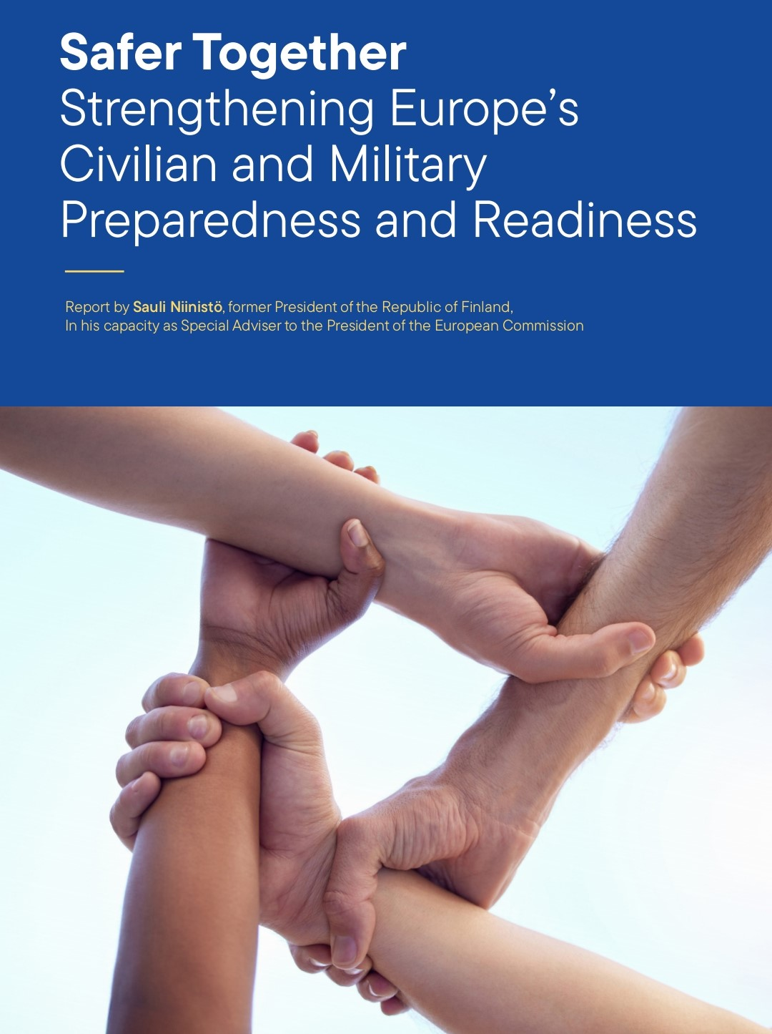
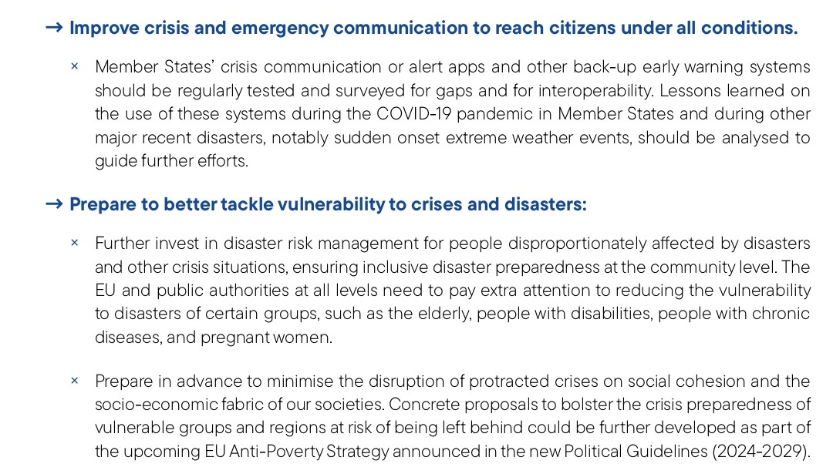
The whole-of- society” approach

Slide 12
Preparedness mainstreamed and targeted in our interventions?
Foresight possible emergencies and how these can affect the communities we work with.
Adapt our processes and methods so that we can operate during the crisis and raise also the awareness of the donors regarding the importance of flexibility and adaptability.
Increase our capacity and knowledge; Create partnerships with organisations which are specialised on thematic areas that we need to develop: climate, disinformation etc.
Develop transnational and transregional communications and partnerships.
Train individuals and communities on crisis related risks and mitigation of risks.
Train the authorities about how crisis might affect in specific and disproportionate ways vulnerable groups.
Advocate for analysis and inclusion in policies and services the needs and circumstances of vulnerable communities.
Develop protocols and lesson learned banks.

Slide 13
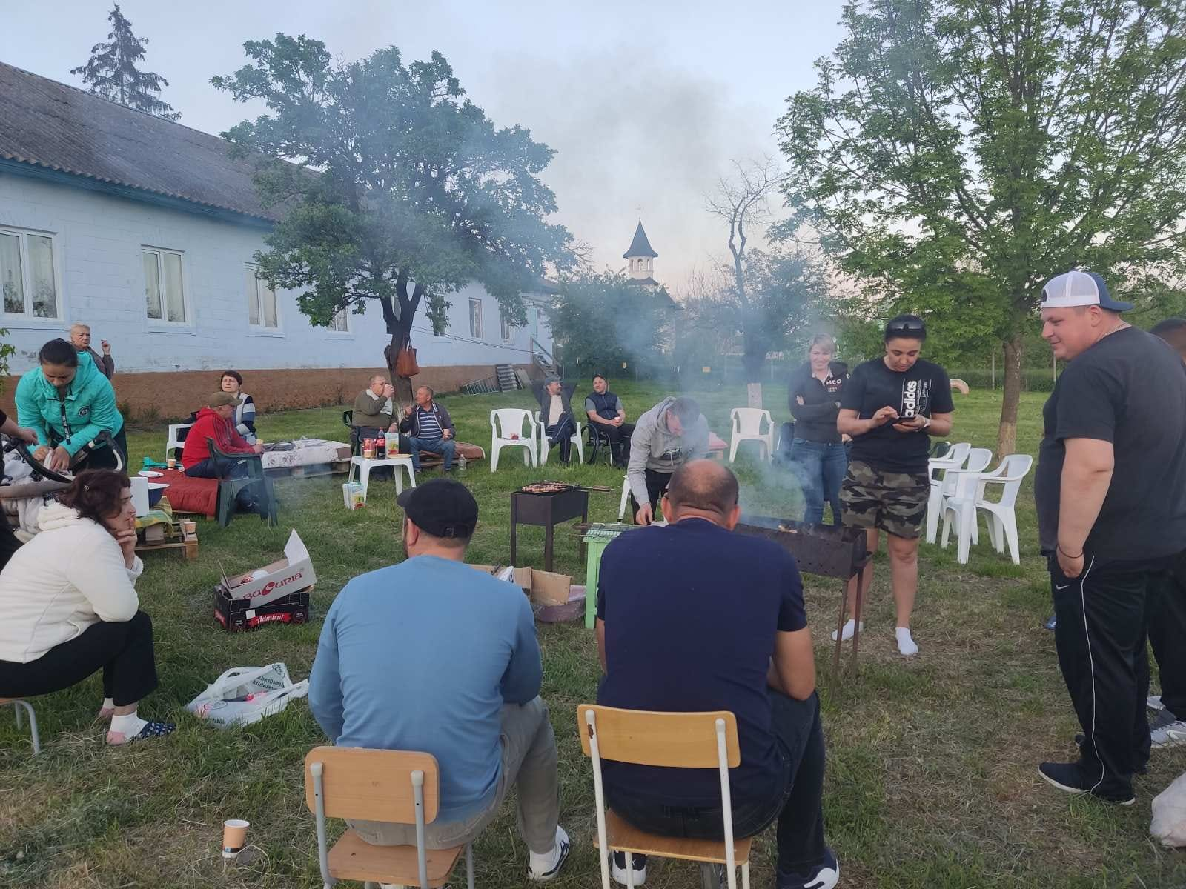
Social cohesion, social participation, equal treatment and opportunity, reconciliation, trust are key to crisis preparedness and resiliency. These are also key to democratic development and rule of law.
As diaconal actors we can provide spaces for debate, spark the debate, support the involvement of ALL in the debates, provide evidence about the importance of societal and institutions trust and belonging.

