Slide 1
Measuring social impact: a new era for the social economy
Karel Vanderpoorten
European Commission

Slide 2
Social impact measurement and management (SIMM)
What is SIMM?
pivotal concept that involves the systematic evaluation
collection and analysis of data
+ strategic application to optimise positive outcomes and mitigate adverse ones.
Why is “Management” added?
measurement not enough to enable evidence-based decision-making and learning.
most powerful when a permanent process: complement strategic planning, reduce risk (e.g. unnecessary actions, waste resources).
repeated measurement and continuous monitoring
adopting a level of quality checks and balances for impact measurement.
From external to external + internal purpose!
Added value?
“Beyond data collection”
empowering organisations to make informed decisions
accountability
transparency
trust among stakeholders.
appeal to investors and donors who prioritise social returns
promoting continuous improvement of programmes and initiatives.

Slide 3
Social impact measurement and management (SIMM)
Challenges
Considerable resources and expertise
Advanced application is complex
Accurate data collection is often difficult
Absence of standardised metrics can make comparisons difficult.
Risk to focus on easily measurable outcomes, potentially overlooking deeper, long-term impacts.
Benefits who?
Nonprofit organisations and social enterprises: assess and enhance their impact,
Investors and donors: to seek assurance of meaningful social returns.
Government agencies: evaluate the efficacy of policies and programmes,
Academics scrutinise outcomes of various social interventions.
Most importantly: communities and individuals who are directly affected by these initiatives have a vested interest in understanding how such efforts influence their well-being.

Slide 4
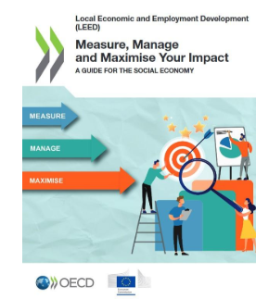
Measure, Manage Maximise… A joint OECD and European Commission Initiative
SIMM needs to be tailored – “no one-size-fits-all”
Current SIMM practices are largely shaped by funders and for-profit organisations - limited focus on social economy.
While for SE measuring social impact = more than accountability.
By systematically measuring: refine strategies, improve resource allocation and ultimately maximise their positive contribution to society.
Impact areas that are particularly important for the social economy: economic prosperity and employment, social inclusion and well-being and community
However: hardest to translate into quantitative metrics.
Simple, straightforward approach for social economy entities to measure, manage and ultimately maximise their impact
Prioritise the use of findings for strategic organisational learning and improvement.

Slide 5
6 Building blocks in the guide
integrating impact evidence into decision-making,
engaging stakeholders,
developing skills,
exploring digital tools for data collection, storage and visualisation,
seeking independent valuation,
establishing a permanent action plan to follow up on learnings

Slide 6
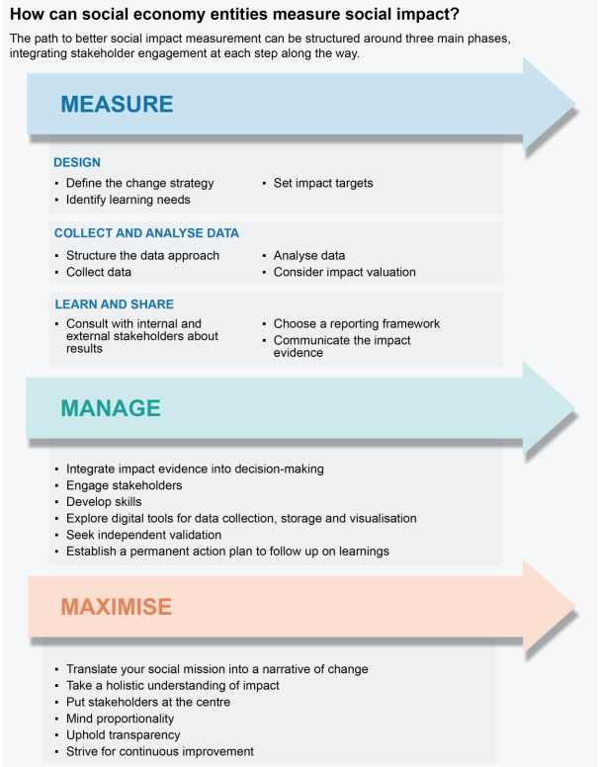
The measurement cycle
Three chronological phases, each composed of several steps:
• Design: define the change strategy, identify learning needs, set impact targets,
• Collect and analyse data: structure the approach, collect data, analyse data, consider impact valuation,
• Learn and share: consult with internal and external stakeholders about results, choose a reporting framework, communicate the impact evidence.

Slide 7
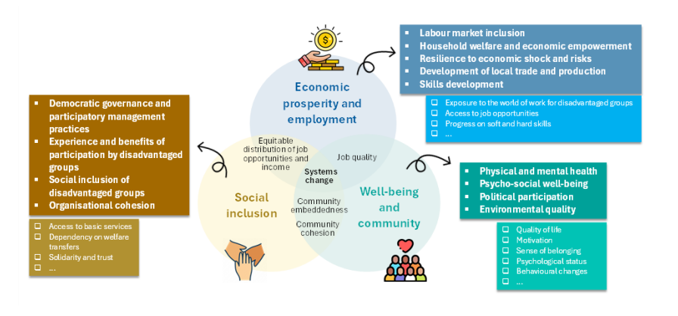
1/ Design - How do SE define what is important to measure?

Slide 8
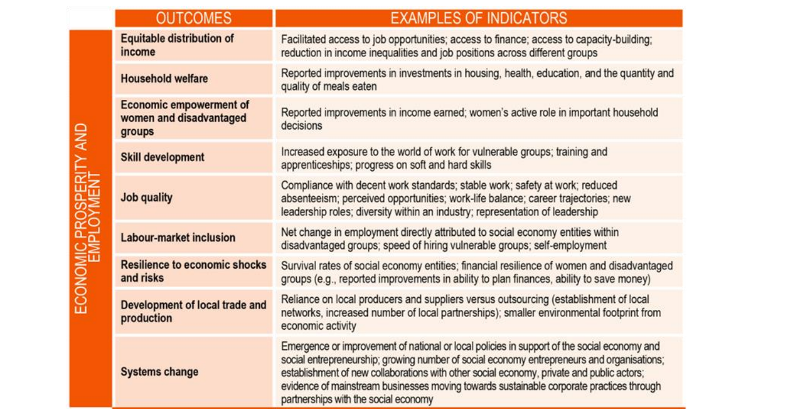
Relevant indicators to measure: Economic & employment

Slide 9
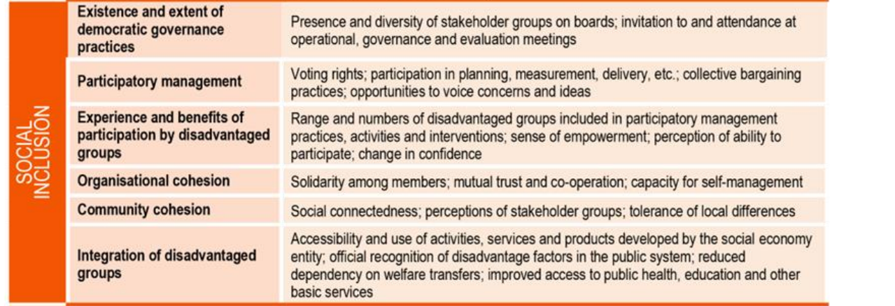
Relevant indicators to measure: Social Inclusion

Slide 10
Relevant indicators to measure: Well-being / community

Slide 11
Example of a job training programme: intervention logic

Slide 12
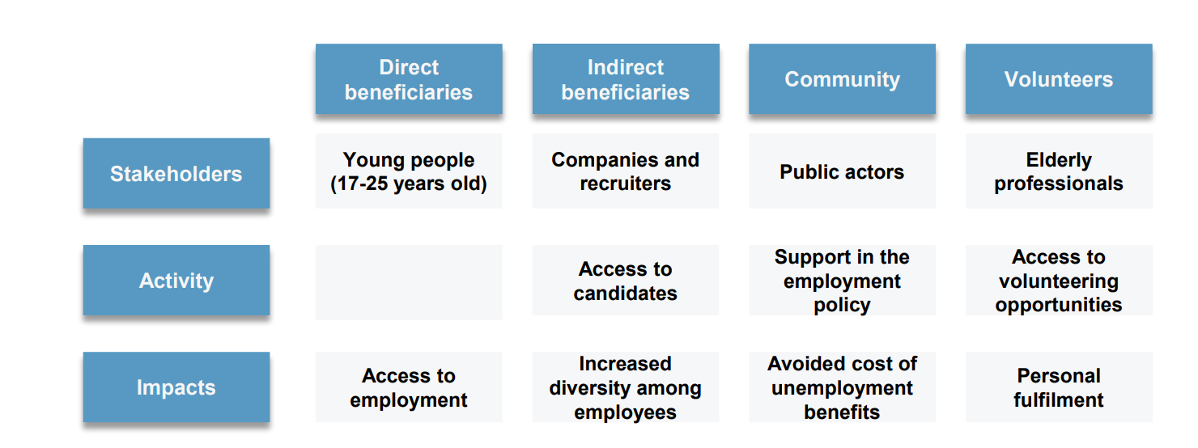
What impacts can be measured?

Slide 13
2/ Collect & Analyse
Structure the collection approach
Feasability
Cost / benefit
Define right indicators
Asses the value of the sources:
Own secundary database
Interviews & Surveys
Measurements (e.g. crowd sourcing)
Case studies
Observations
Customer journeys.
Analyse
Yes, it’s about statistical techniques and analysis = Skills!
Consider monetisation techniques
SROI
Stakeholders accountability vs Management purpose
➔ What do they want to know
➔ What do you want to monitor and improve?

Slide 14
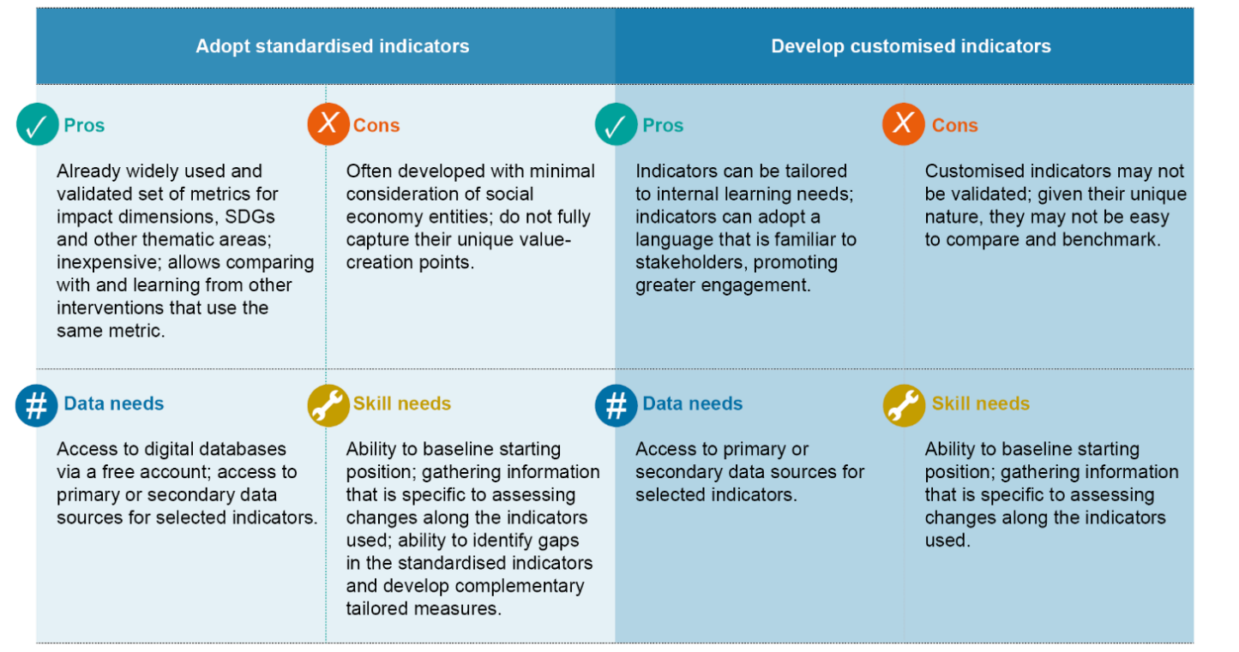
The right indicators: crucial decision

Slide 15
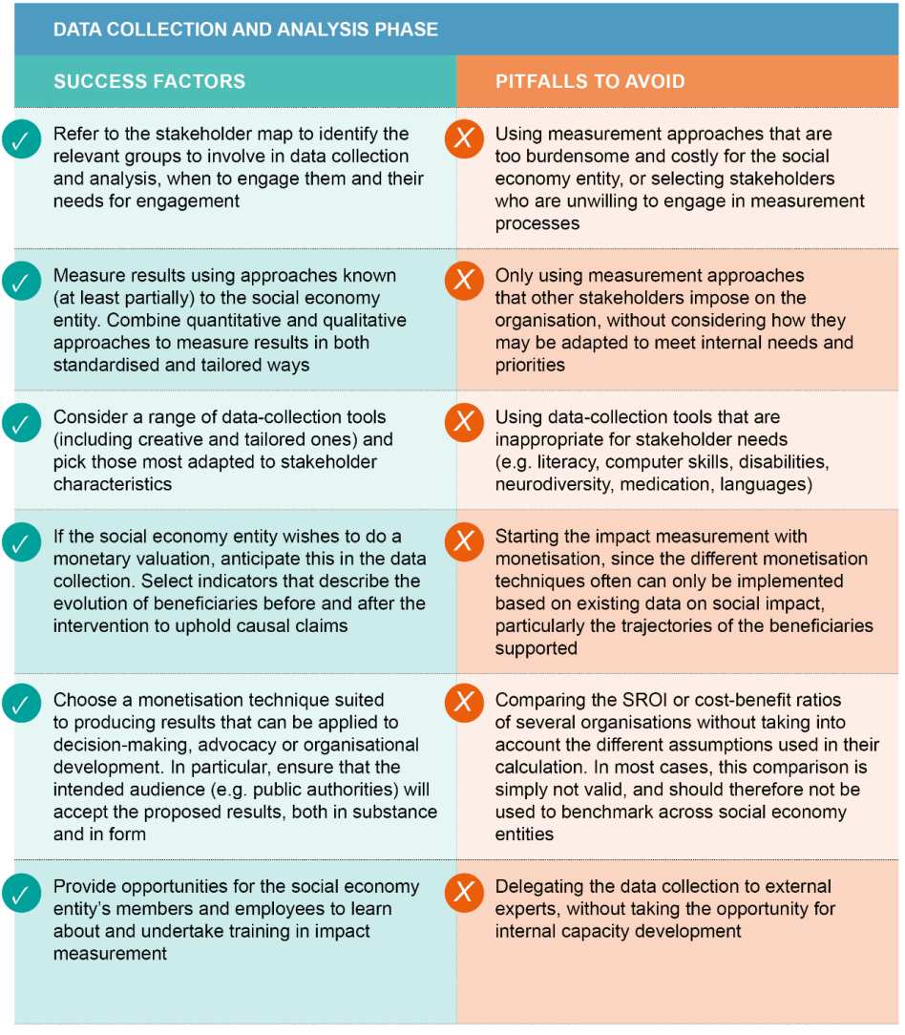

Slide 16
3/ Learn and share: 3 steps
1. Consulting with stakeholders
Consult with internal and external stakeholders about results
Creates a feedbackloop: adaptation
! Tensions between different stakeholders needs – adapt message
Recommendations

Slide 17
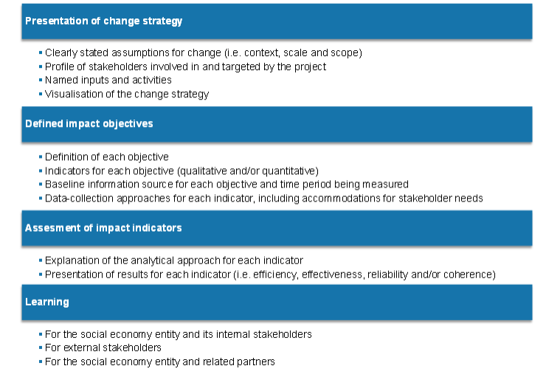
3/ Learn and share: 3 steps
2. Choose a reporting framework: accountability vs learning!

Slide 18
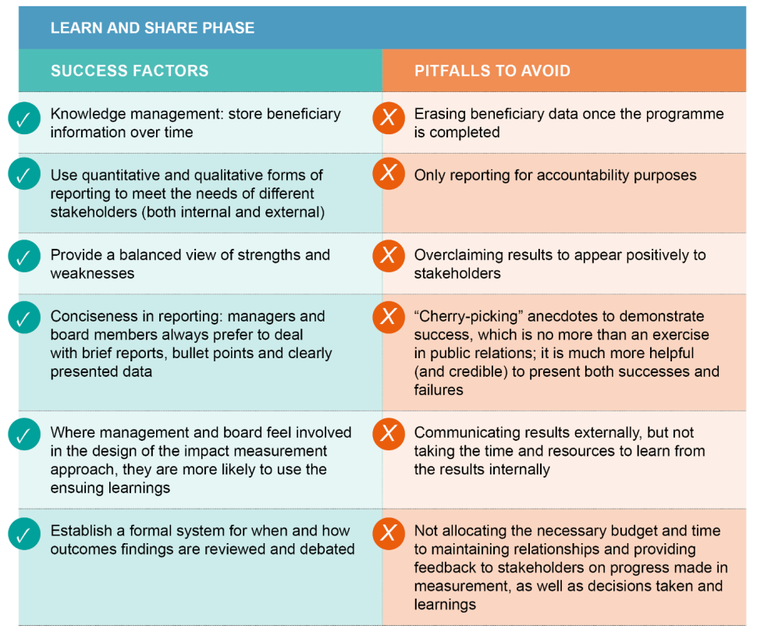
3/ Learn and share: 3 steps
3. Communicating the results internally and externally

Slide 19
Social Innovation Call for Proposals:
Actions to develop impact performance intelligence services
What is the call about?
The call aims at promoting informed and better investment decisions, greater market transparency, and performance benchmarking in the field of social impact investments (i.e. supporting knowledge and trust in the market through strengthening the impact management industry).
What is the funding going to cover?
scale up activities of already available services or products (from product market-fit to profit-market fit phase);
development of new services or products (from ideation to go-to-market phase)
And in more simple terms?
The social impact investing market does not have proper and tailored rating agencies, intelligence agencies, data and analyses providers, etc.
The call aims at filling this gap, providing funding to those actors that are already established but suffer barriers to their growth, or to new actors that can envisage how to address this important market need.
Impact intelligence services may include:
reporting tools;
online analytical processing;
predictive or prescriptive analytics;
dashboards development;
data, text or process mining;
complex event processing;
business performance management;
benchmarking, rating and signaling;
Projects have started in Q1 of 2025 and first results are expected as of Q2 2026

Slide 20
Thank you
More info: Measuring social impact: a new era for the social economy? - European Commission
Contact: EU-Social-Economy-Gateway@ec.europa.eu
Linkedin: https://www.linkedin.com/company/eu-for-social-economy-and-social-enterprises/

