Slide 1
Navel - What can a social robot do for people in a nursing home?
Eurodiaconia ANNUAL GENERAL MEETING 2025
Workshop: What Perspectives for AI and New Tech to Measure Impact of Social and Health Services?
Katrin Baumgärtner, Institut für Pflege und Alter (IPA), Evangelische Heimstiftung
03.04.2025

Slide 2
Who we are

Slide 3
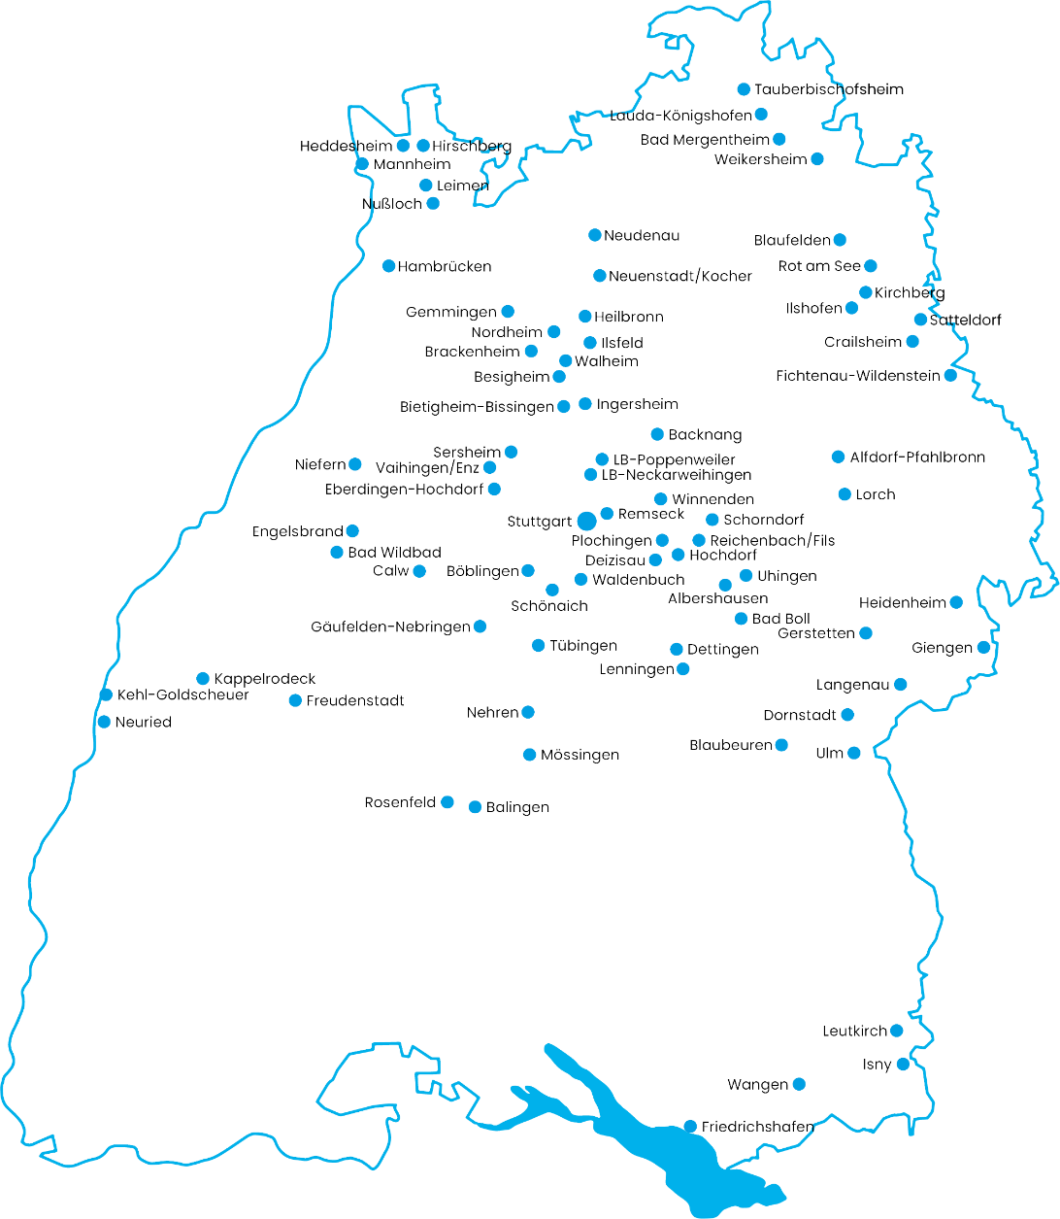




Evangelische Heimstiftung
the largest diaconal and non-profit care company in Germany (based only in Southern Germany)
We provide „Gute Pflege“ („Good Care“)
… for 15.000 people in need of care
… with 10.700 employees.
… in 173 facilities

Slide 5

EHS corporate strategy 2035
Self-understanding and diaconal profile
Who are we and
what do we stand for?
Products, Services and neighbourhood
What do we offer, where and for whom?
growth
How do we develop further?
Economic Efficiency
How do we earn
our money?
innovations
How are we shaping
the future?
Sustainability
How can we take responsibility for people and the environment?
digitalization
How can we bring
together people and technology?
Human Ressources
What kind of employer are we?

Slide 6
Robotics in Elderly Care

Slide 7


Robotics in Elderly Care
Demographic challenges: While the proportion of elderly people in need of care is increasing, the number of professional caregivers is declining
Hope to reduce the discrepancy between care needs and caregivers through technological developments
Fields of application and potentials of robotic systems:
  service/transport
  relief/support
  activation/entertainment
  Improvement of quality of life/participation
(Federal Statistical Office of Germany, 2024; Ohneberg et al., 2023; Silvera-Tawil et al., 2024 )

Slide 8
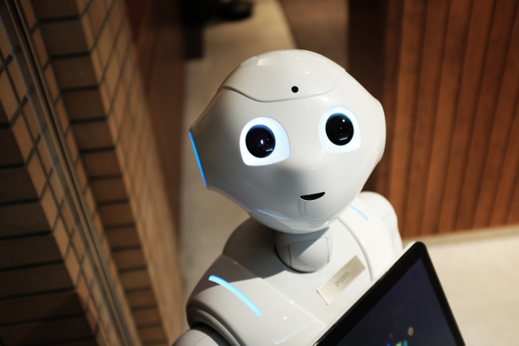

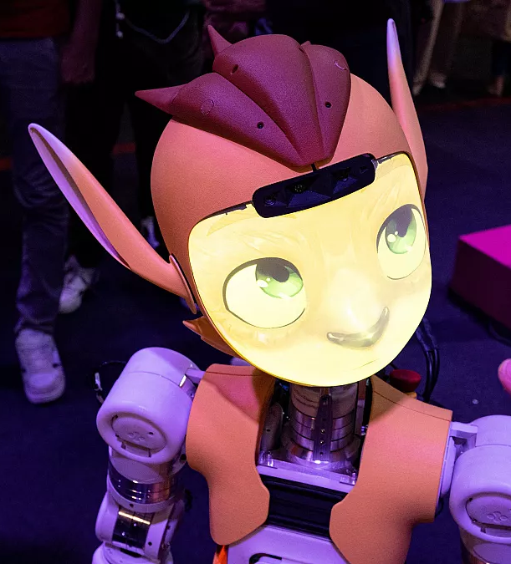
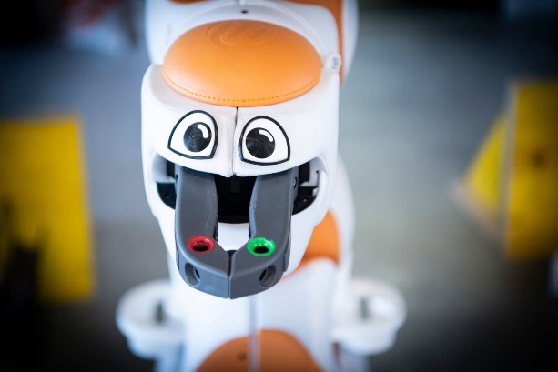
Social robots
Specifically developed for interaction and communication with humans
Most often human- or animal-like appearance
Intended to actively build a social relationship with people
Primarily fulfill communicative and emotional needs

Slide 9
The social robot „Navel“

Slide 10
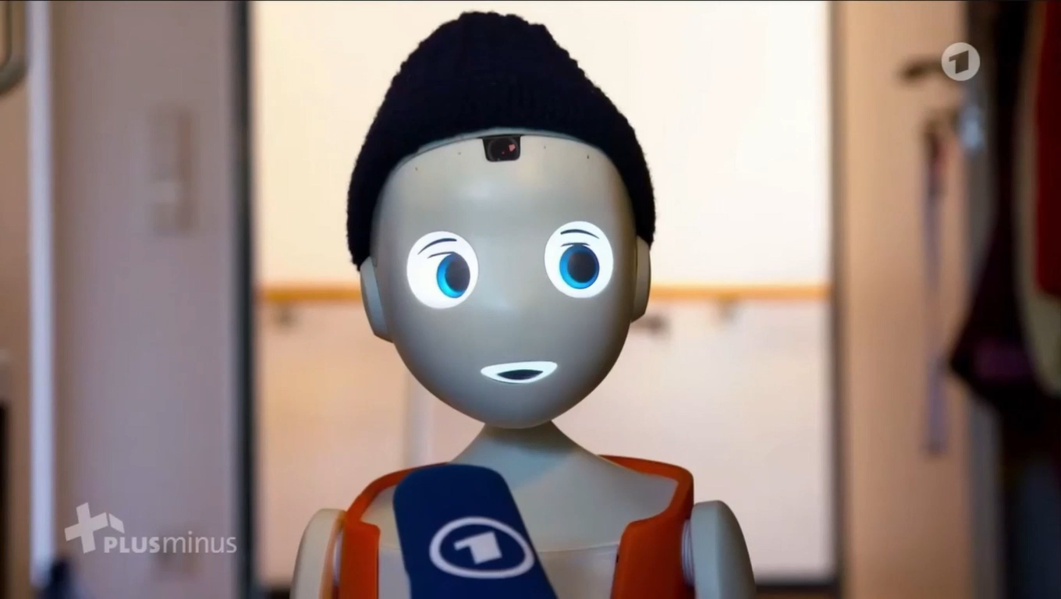

Slide 11
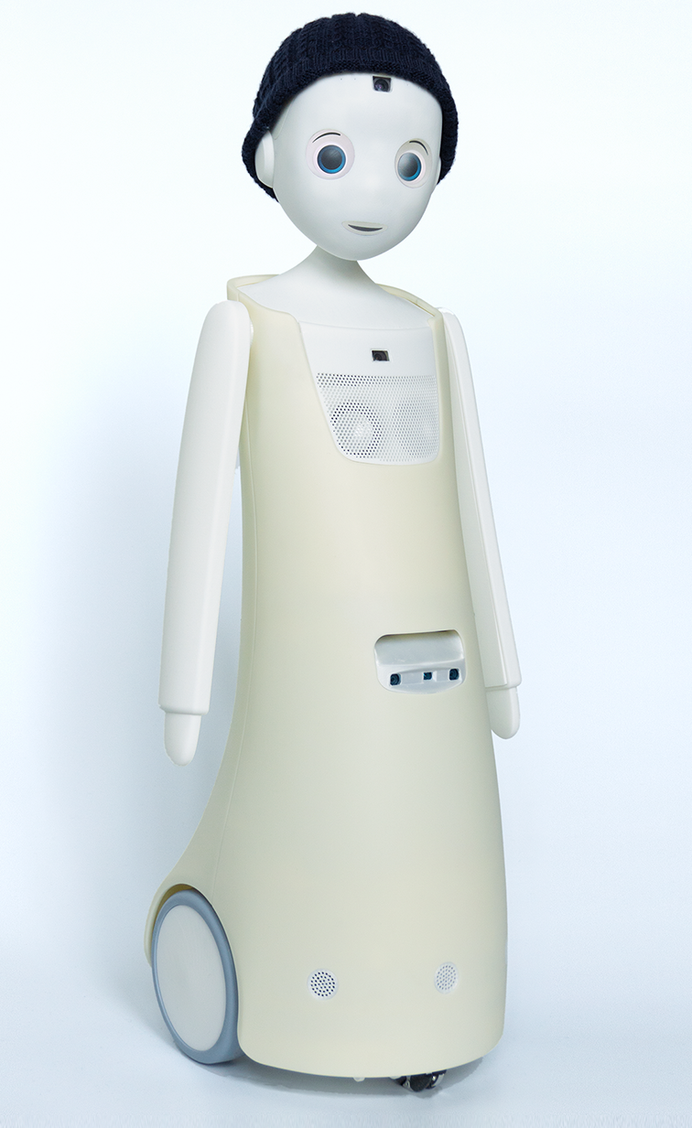
Navel - construction
Head-mounted camera for facial recognition and
microphones
Eye display and mouth display
Head motor
3D camera and chest camera for navigation
Shoulder motor
Drive wheels
Head motor
Head motor

Slide 12
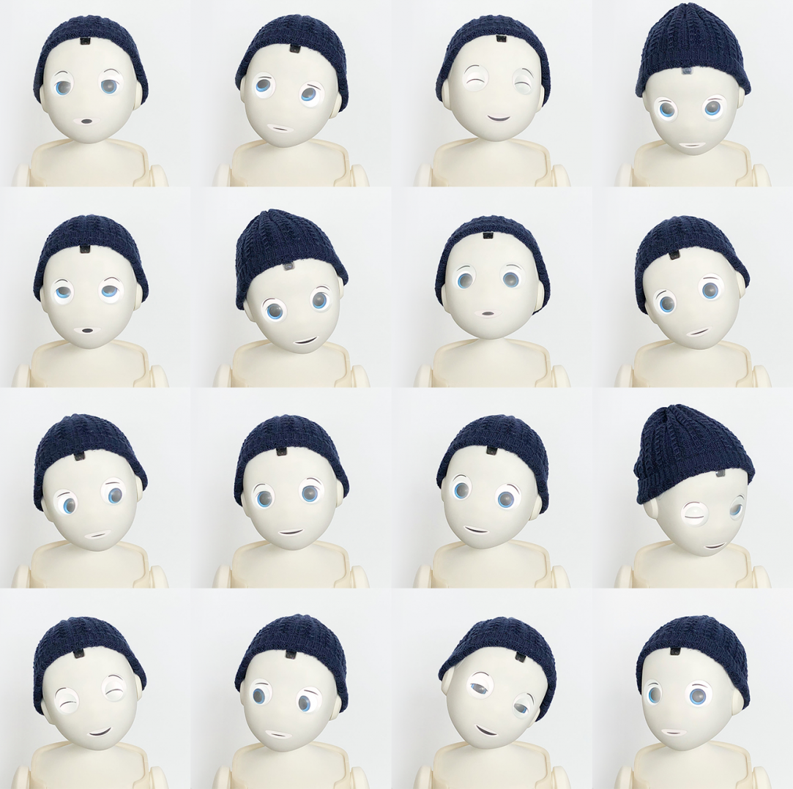
  Verbal and non-verbal communication through language (Chat GPT) and expressive facial expressions
  Ability to perceive social signals through AI and respond to them in an "empathetic" way

Slide 13
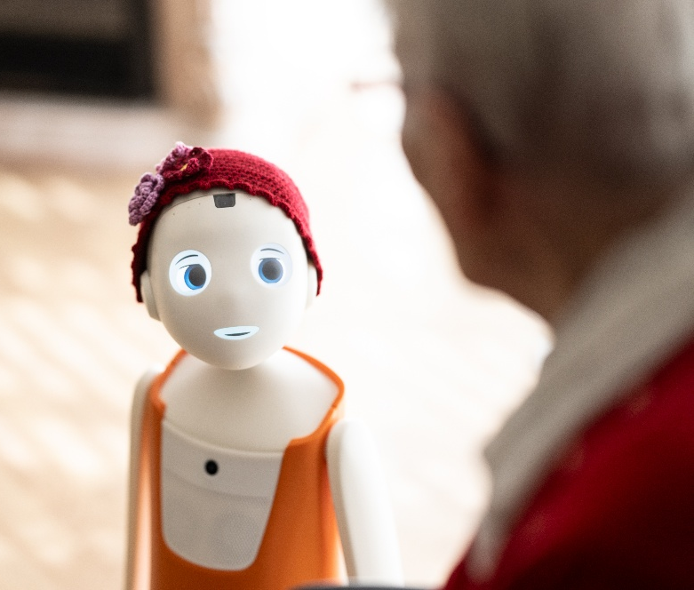
The social robot „Navel“
  Emotional and cognitive activation
  Personal greeting
  Inquiring about well-being
  Engaging questions
  Games, jokes, poems
  Provide information

Slide 14
Study
What can a social robot do for people in a nursing home?

Slide 15
Project Timeline

Slide 16
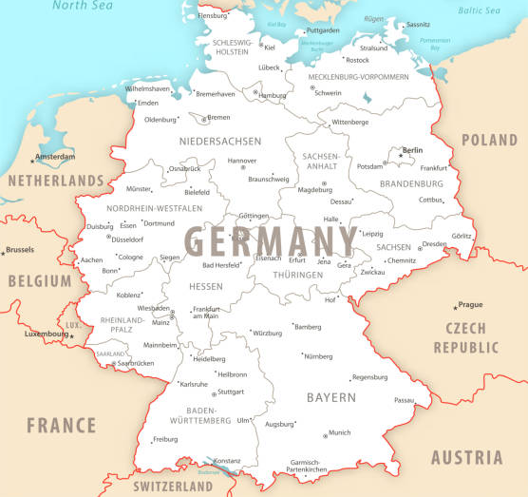

Preparation and Pre-survey
The Pilot Facilities
Haus im Wiesengrund
Albershausen
50 Care places
Navel since Oct. 23
Seniorenzentrum Rheinauer Tor
Mannheim
90 Care places
Navel since Dec. 23

Slide 17
Preparation and Pre-survey
Pre-survey with Staff
39.8% of the staff participated in the questionnaire survey
The majority were female (82%); the largest age group was 36-45 years old.
Most participants were curious and interested in new technologies.
Men and younger age groups showed a higher readiness for technology.
Pre-Study (T1)
Expert interviews
(with managers)
n = 6
Questionnaire survey (Professional caregivers /Daycare companion)
n = 51
Age Groups

Slide 18
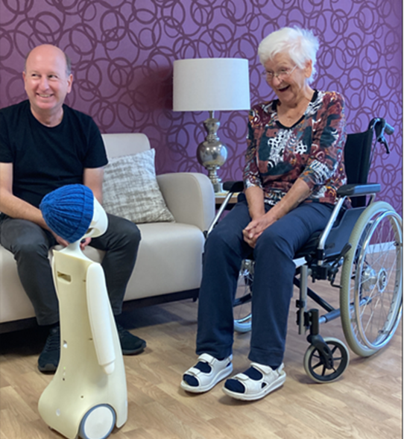
Preparation and Pre-survey
Staff attitudes towards social robots
n = 51
..are positive towards the use of social robots in care
…think that a social robot would evoke positive feelings in the residents
agree neither agree or disagree disagree

Slide 19
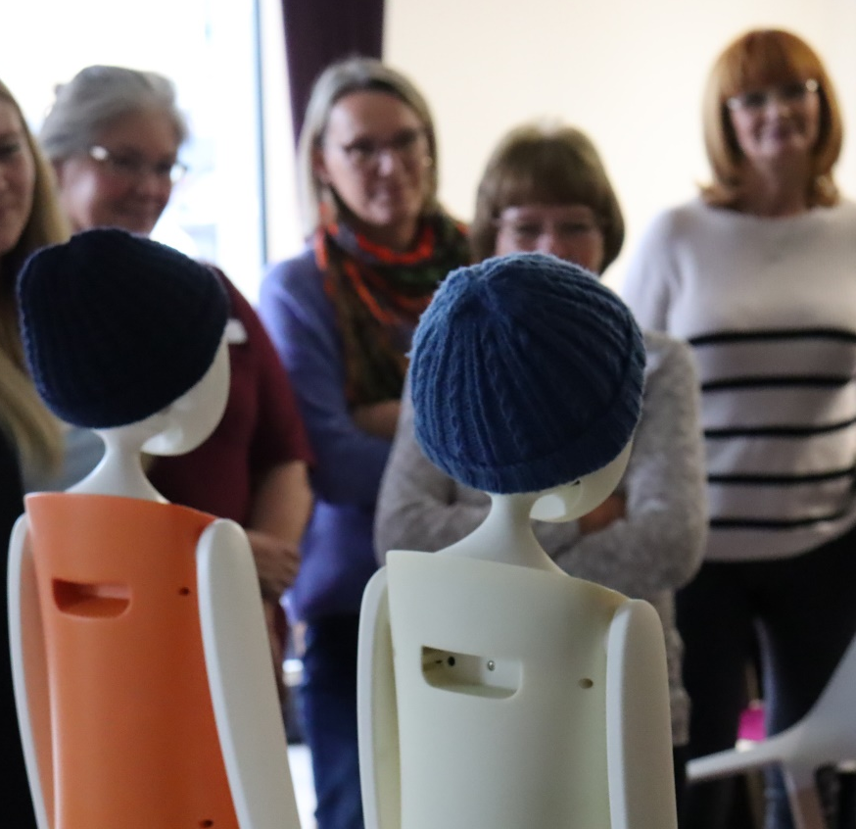
Preparation and Pre-survey
Staff attitudes towards social robots
n = 51
… think that social robots in care will become more important in the future
…believe that the use of social robots will relieve staff.
Foto: EHS
agree neither agree or disagree disagree
Notes:
There are uncertainties about the practical benefits and relief for staff.
Leaders see potential for social robots, especially in interacting and communicating with residents.

Slide 20
Preparation and Pre-survey
Key Findings
Opportunities
Digitalization could make the profession more attractive and draw in young people.
Robots could fill care gaps and promote positive social interactions.
There is hope that Navel will contribute to a positive social atmosphere and reduce negative emotions like loneliness.
Use Scenarios: Robots could be used with people with dementia and withdrawn individuals.
Challenges
Concerns about suitability in palliative care situations and potential fall risks
There is a possibility of negative reactions, especially among people with dementia
Careful implementation and training are crucial. Data protection and ethical issues need to be addressed.
There is concern that robots might replace jobs.

Slide 21
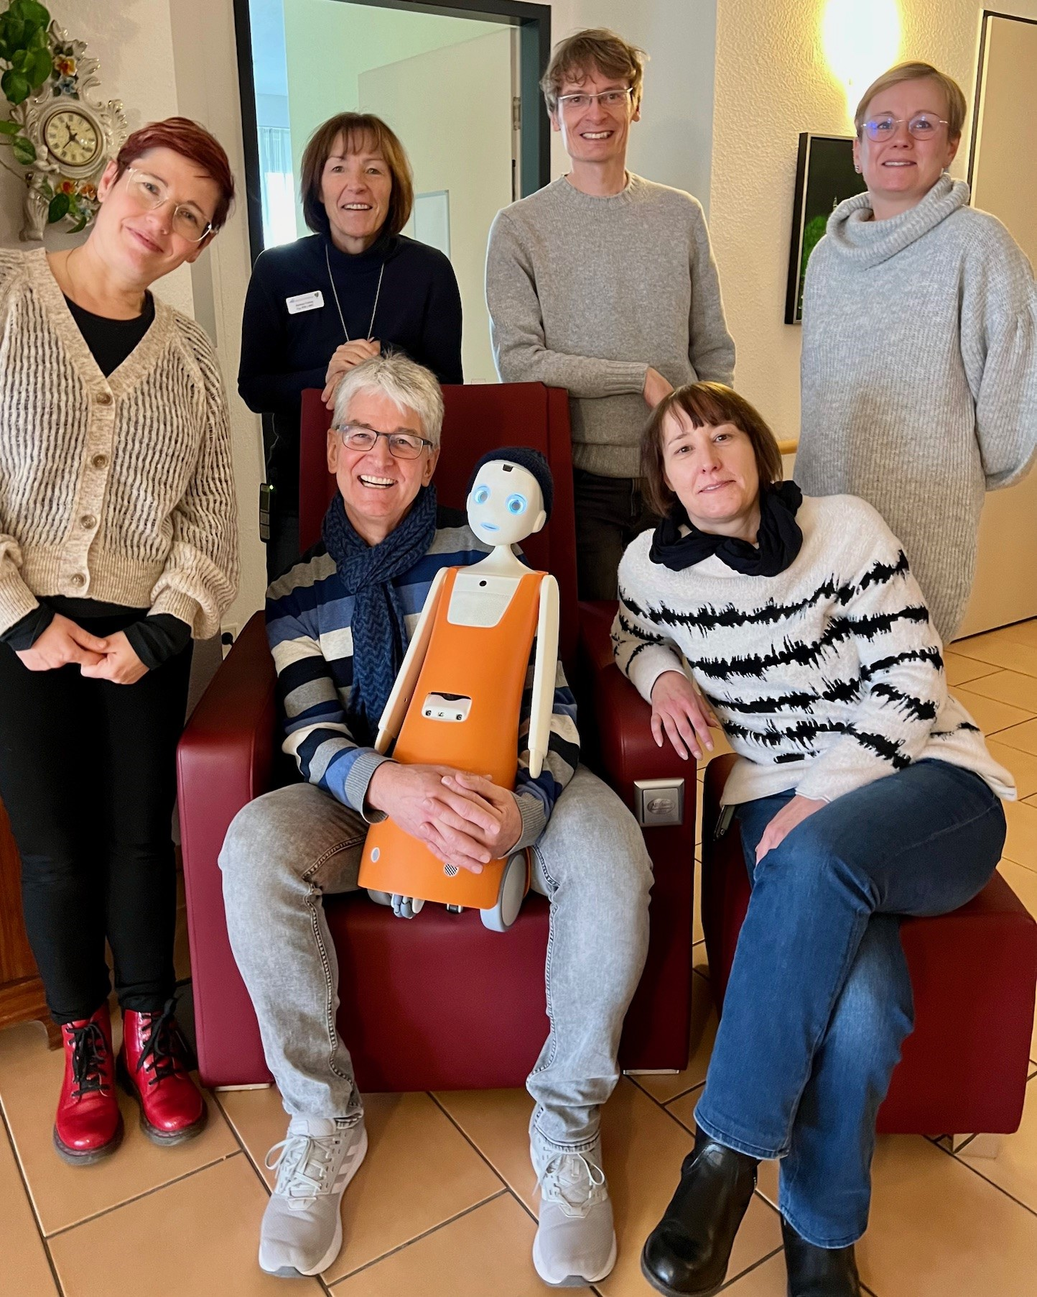
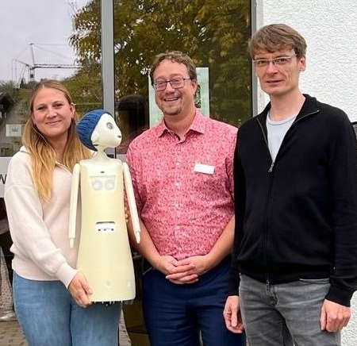
Introduction
Project Teams:
Leadership and two "Navel Mentors" per facility.
Mentors coordinate robot use and communicate with developers.

Slide 22
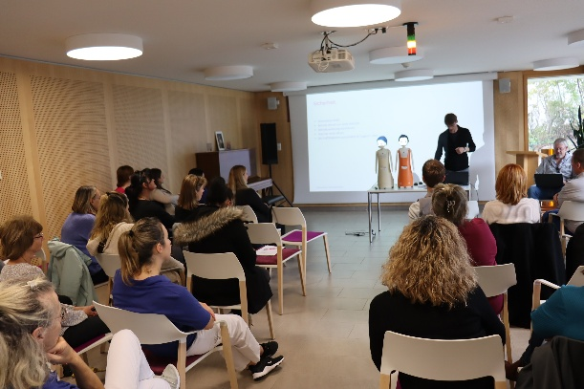
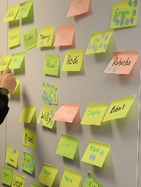
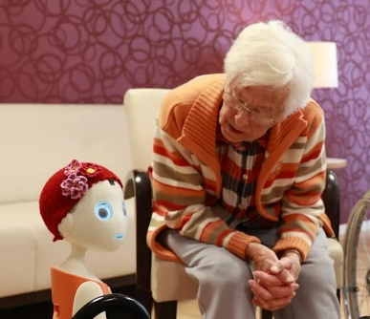
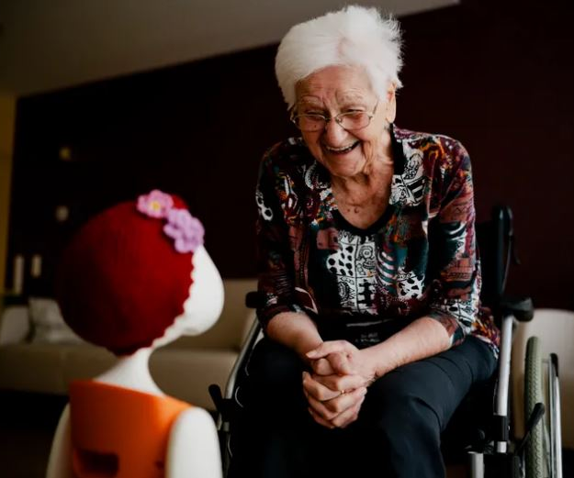
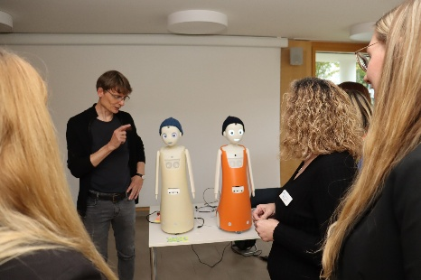
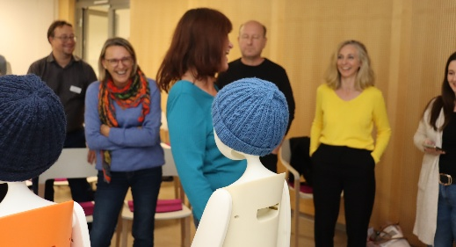
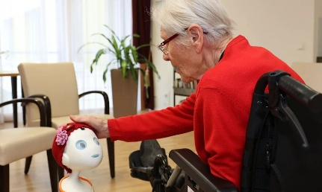
Introduction
Day 1
Day 2
Functionality overview and naming process.
Introduction to residents and initial interactions

Slide 23
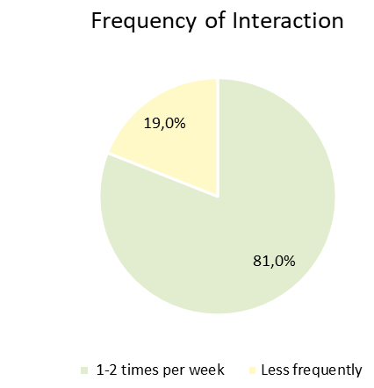
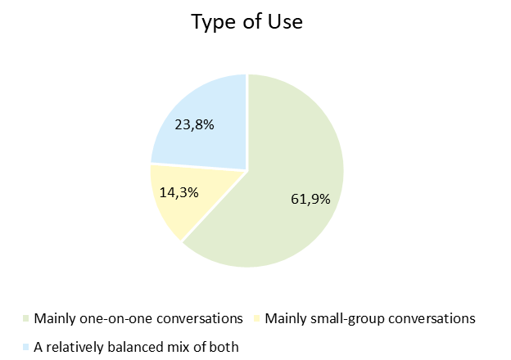
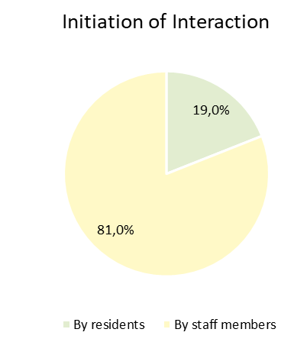
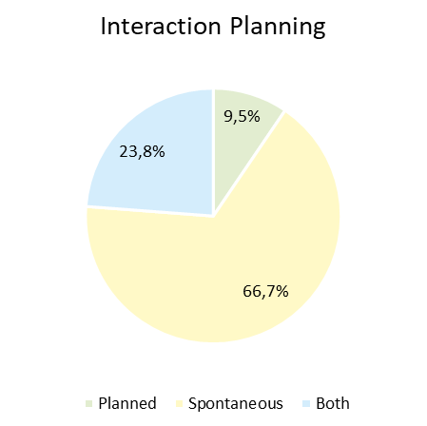
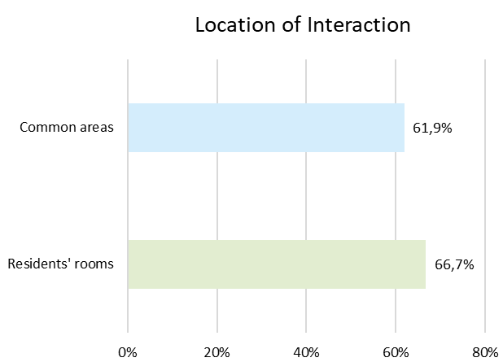
Practical phase
Navel in Practical Use
Consent obtained from ~30% of residents
Typically used 1-2 times per week as part of daily support activities
Most interactions were spontaneous, primarily initiated by staff
Conversations were guided by "Navel mentors“
Average interaction duration: 17.6 min (range: 10-30 min)
Predominantly one-on-one conversations, rarely small group interactions
Used in both residents’ rooms and common areas
Preferred interaction types: Jokes (71.4%), small talk (61.9%), and poems (57.1%)

Slide 24
Practical phase
Results of the polarity profil (residents’ perspective; n=22)

Slide 25
Practical phase
Results of the polarity profil (residents’ perspective; n=22)

Slide 26
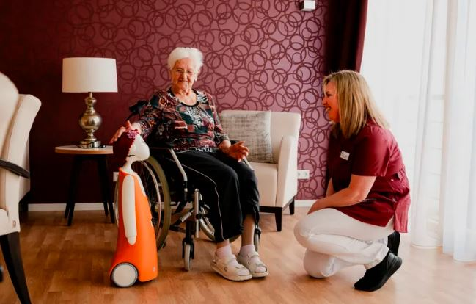
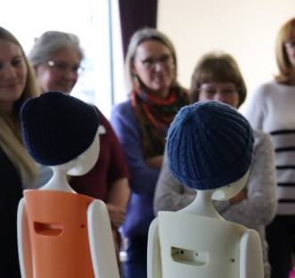
Practical phase
Key Findings
Results of Resident Interviews:
Good acceptance and response from many residents (appearance, communication behavior).
Positive effects on emotional well-being (fun, joy, entertainment, encouragement, variety, enrichment of daily life).
Perception of Navel as an inanimate figure, yet partial humanization and emotional attachment, also expressed through touch (e.g., stroking the head).
Results from Focus Groups with Staff:
Ambivalence among staff, with some discrepancy between hopes/expectations and reality.
Positive impacts on residents are recognized.
Technical improvements and further development are needed to enhance acceptance, provide support/relief, and create added value.

Slide 27
Follow-up survey
44 participants, response rate of 34.8%.
82% female, 18% male; majority in the 46-55 age group.
51% in nursing, 49% in daily care assistance.
Staff mostly acted as observers, less as active companions.
Nursing staff had less contact with the robot.
Follow-up survey (T2)
Expert interviews
(HD, PDL, LATB)
n = 6
Questionnaire survey (Professional caregivers /Daycare companion)
n = approx. 44

Slide 28
Follow-up survey
Key Findings: Staff Perspective
(n = 44, professional caregivers and daytime companions)
Effects on Residents
Effects on Staff

Slide 29
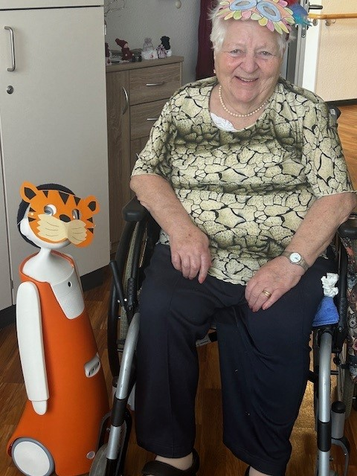
Follow-up survey
Key Findings
Mixed views on the robot's impact
Seen as beneficial for entertainment and engagement.
Over one-third say Navel brings joy and complements care.
Usability needs improvement.
Issues with slow response times and limited functionality.
Over two-thirds of staff not feeling supported.
But still, 37% want to keep Navel in the facility

Slide 30
Lessons Learned
Social robots show potential: Their primary value is in engaging and activating residents rather than reducing staff workload
Expectation vs. Reality: Clear communication is essential to manage expectations and prevent disappointment
Integration is not self-sustaining: The robot requires continuous human supervision and guidance to ensure meaningful interactions
Acceptance depends on usability and further development: Improving user-friendliness and expanding functions (e.g., mobility, facial recognition, singing, multilingual support) is crucial for long-term adoption

Slide 31
Ethical Aspects of Using Social Robotics at EHS
EHS already had ten ethical guidelines for a human-centered digitalization.
  Technology for People: Enhances independence and complements human care.
  Protect Privacy: Careful data handling, preserving intimacy.
  Care for the Vulnerable: Special review for non-consenting individuals.
  Promote Inclusion: Barrier-free access, no harmful communication.
  Ensure Data Security: Transparent practices, compliance with data protection laws.
  Value-Oriented AI: Algorithm transparency, no delegation of ethical dilemmas to systems.
  Focus on Customer Needs: User-friendly applications, design meets needs.
  Employee Qualification: Enhance digital skills, encourage innovation.
  Sustainability: Conserve resources.
  Continuous Reflection: Evaluate technology use and risks, interdisciplinary dialogue.

Slide 32
  Ethical Aspects of Using Social Robotics in Care
1. Subjective Benefit for Clients:
Social robots should enhance the well-being of individuals in care without replacing human interaction.
They should evoke positive feelings and reduce negative emotions without reinforcing negative thought patterns.
Concerns and fears are taken seriously to prevent negative effects.
2. Proper Preparation:
Clients, relatives, and staff are prepared for the use of social robots through informational events and training sessions.
3. Support for Staff:
Social robots should relieve staff by providing additional care and entertainment.
They can free up time for staff to focus on other tasks.
4. Reliability and Safety:
Robots must be technically reliable and safe, tailored to the needs of care facilities.
Personal data and privacy are protected.

Slide 33
  Ethical Aspects of Using Social Robotics in Care
5. Differentiated Evaluation of Use Cases:
The use of social robots is evaluated individually, especially for vulnerable groups like people with dementia.
6. Fair Use:
No one is excluded from using social robotics; everyone has equal access opportunities.
7. Respect for Personal Boundaries:
Usage is self-determined, and consent from those involved is required.
There is a right to "non-use."
8. Weighing Costs and Benefits:
Costs and benefits are carefully evaluated, ensuring that the benefits outweigh the costs.

Slide 34

For further details, access our full report here: (only in German)
Katrin Baumgärtner
Referentin
Institut für Innovation, Pflege und Alter (IPA)
Evangelische Heimstiftung GmbH
Hackstraße 12
70190 Stuttgart
Tel. 0711 63676-186
katrin.baumgaertner@ev-heimstiftung.de

