Slide 1
What does the Green Transition mean for social services?
Designing socially just climate policies
16. May 2024
Anna-Lena Guske
Projektleitung Sozialökologische Transformation
Zentrum Soziales und Beteiligung
Diakonie Deutschland
Notes:
Project duration: 3 years (October 1, 2022-September 30, 2025)
Goals of the project:
How can it be ensured that burdens are distributed fairly during the transformation and that ecologically sustainable participation is possible for everyone?
Which instruments are suitable for driving forward the social-ecological transformation and at the same time avoiding unreasonable burdens? (politically (e.g. tax and regulatory policy instruments) and within Diakonie Deutschland)

Slide 2
Diakonie Deutschlands’ basic assumptions re climate protection/ social-ecological transformation
Ecological and social goals must not be played off against each other.
Climate protection is an investment in the future.
The climate crisis does not affect everyone equally.
Not all people are equally responsible for the climate crisis.
The costs of climate protection do not affect everyone equally.
Climate protection can and must be designed in a socially just manner.

Slide 3
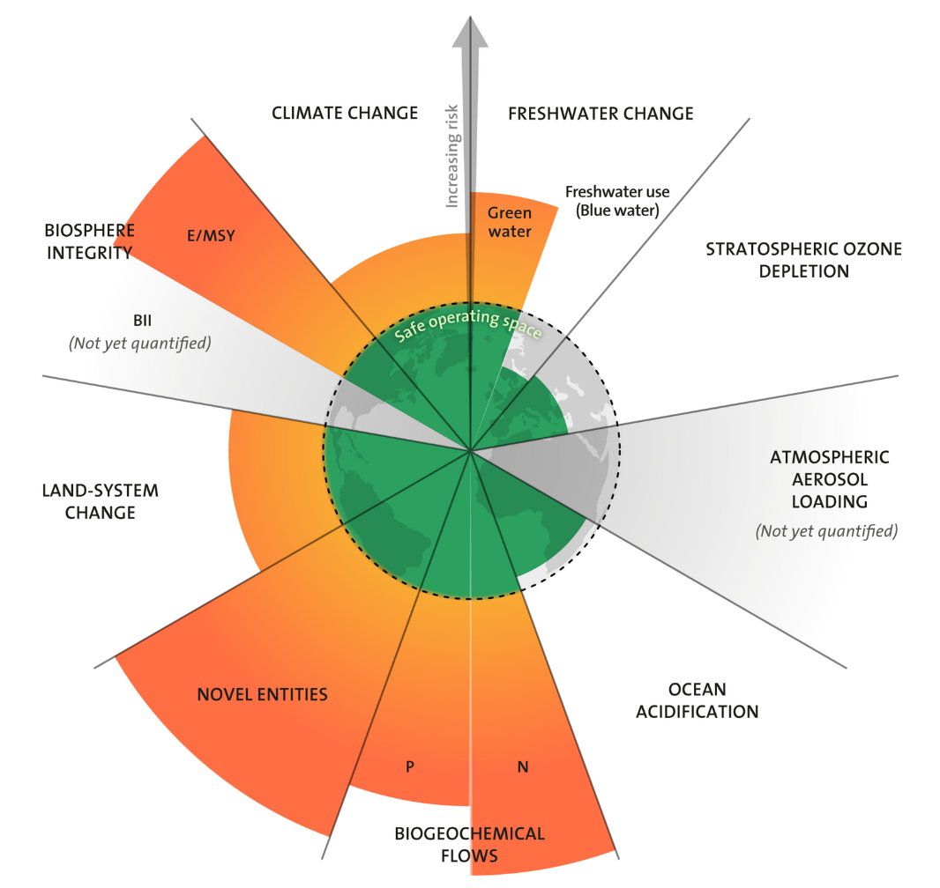
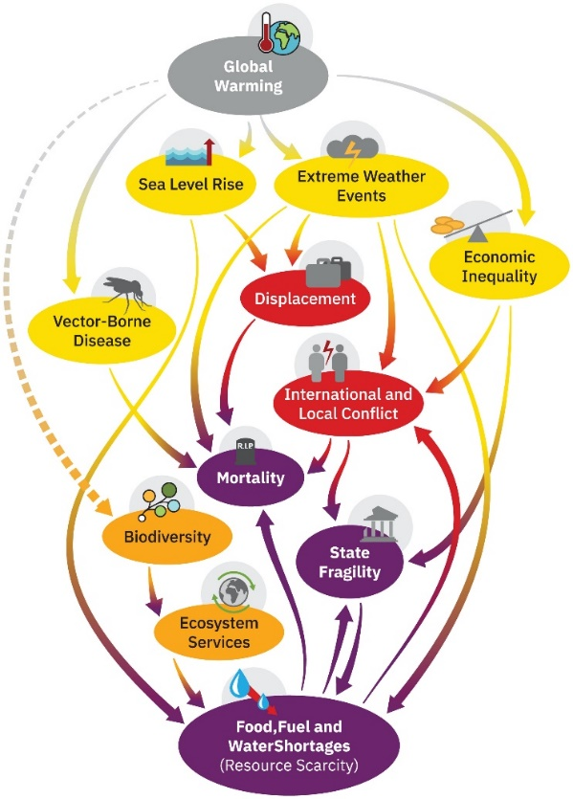
Climate protection is an investment in the future
The earth's carrying capacity has limits
  Some of these limits have already been exceeded, others we are close to
The consequences of climate change are already noticeable today
Climate change is having a particularly drastic impact in the global south
  But it is becoming increasingly clear how climate change will affect us in Europe
Climate protection preserves the basis of life for future generations

Slide 4
The climate crisis does not have equal effects on all
No climate protection can increase social inequality because:
Health risks increase:
  Heat-related health risks are increasing (e.g. cardiovascular diseases, allergies)
The increasing health risks particularly affect older people, children and people with previous illnesses, and low-income groups
Costs rise even without climate protection, for example:
  Damage caused by extreme weather events
  Investments in infrastructure to adapt to climate change (e.g. better insulation/shading of living spaces to protect against heat)
  rising food prices due to crop failures due to extreme weather events
Rising costs particularly affect households with low incomes more severely
As a result, ethnic minorities, indigenous populations, low-income communities, migrants and displaced persons, sexual and gender minorities, are the groups most likely to face more severe impacts from climate change in the future.

Slide 5
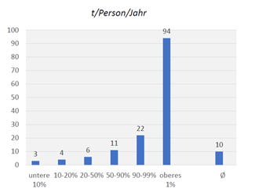
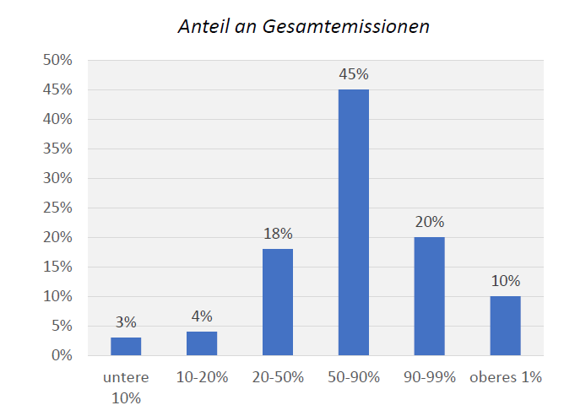
Not all people are equally responsible for the climate crisis
The following applies in Germany and worldwide:
  Those who have a high income have a larger carbon footprint
Wealthy households
  are obliged to reduce CO2 emissions more
  have more options to adopt more climate-friendly consumption and behavior patterns (e.g. installing PV systems in your own home, switching to electric cars, etc.)
BUT: in order to achieve the CO2 targets, lower-income households in Germany also have to reduce CO2 emissions
Source: Held, B. (2023): Teilhabe an der sozial-ökologischen Transformation für alle Menschen Sicherstellen – Herausforderungen und neue Ansätze für den Sozial- und Wohlfahrtsstaat. Keynote speech at the conference: Ein Nachhaltiges Leben für Alle ermöglichen – Den Wohlfahrtsstaat in der sozial-ökologischen Transformation neu denken.“ at Diakonie Deutschland, 29. June 2023 in Berlin
Notes:
Grafik zeigt CO2-Emissionen in Tonnen pro Person im Jahr nach Einkommensverteilung in Deutschland, Quelle der Daten von Benjamin Held ist die World Inequality Database 2023
Klimaverträglich wäre es, wenn weltweit pro Kopf nicht weniger als 1 Tonne CO2 pro Jahr ausgestoßen wird. Mit 3-6t ist somit der CO2-Ausstoß auch von den Bevölkerungsgruppen mit niedrigerem Einkommen zu hoch

Slide 6
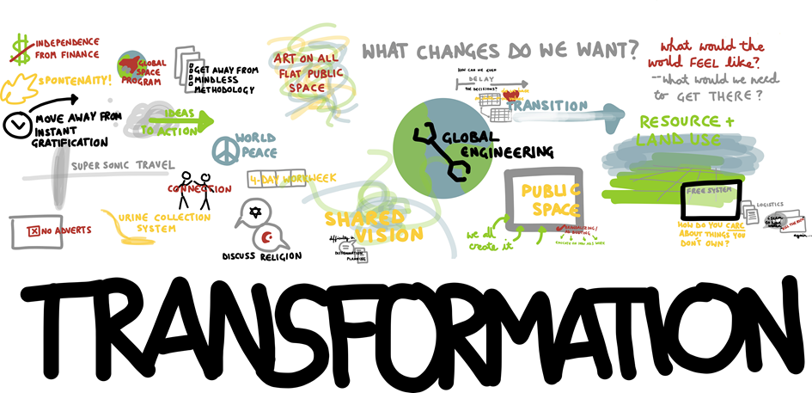
Climate protection requires change
Climate protection means restructuring our economy
  Investments are necessary in
    New technologies (more efficient production methods, expansion of renewable energies, etc.)
    New infrastructure (e.g. expansion of public transport)
Climate protection also requires us to rethink and question our actions as consumers
What is crucial is that the burden is distributed in a spirit of solidarity and fairness!
Those who cause more environmental damage should also bear a corresponding share of the costs
Politicians have a duty to create the framework conditions for this
Notes:
Energiepreise (z.B. Ausbau erneuerbarer Energien)
▪ Investitionen in neue Infrastrukturen, Technologien (sowohl gesamtgesellschaftlich, durch die Industrie als auch den Einzelnen (s. Heizungstausch, E-Autos, etc.)
o Erfordert Umdenken und Hinterfragen des eigenen Handelns: nachhaltiger Konsum
▪ Industrie/ große Produzenten tragen auch große Verantwortung, es braucht Regulierung, spricht den Einzelnen aber nicht frei: das heißt, Einzelne brauchen Handlungsspielräume

Slide 7

The costs of climate protection do not affect everyone equally
Additional costs due to new climate protection requirements place a proportionally greater burden on low-income households, e.g.
  New requirements for the energetic condition of buildings
  Potential higher costs for renewable energy
  Higher costs of ecologically produced foods, electricity, sustainable mobility options
Just as rising costs caused by climate change, rising costs because of climate protection measures also particularly affect households with low incomes
In Germany this means: the social security rates are clearly too low to make ecological consumption possible. Recipients of basic security thus (involuntarily) become a major market power for dumping products.
  Therefore, Diakonie Deutschland currently develops a concept for a social-ecological subsistence minimum

Slide 8
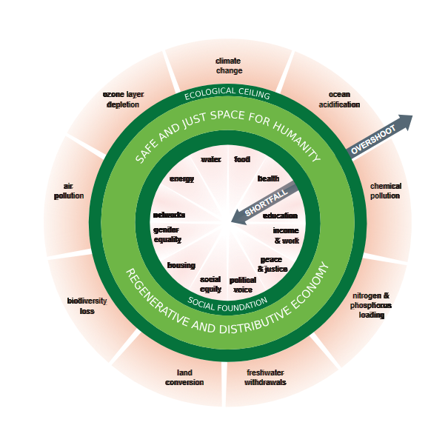
Climate protection can and must be designed in a socially just manner
Adapted from Kate Raworth's theory of donut economics:
In addition to the planetary boundaries that must not be exceeded, there are also social boundaries that must not be fallen below
  This also means that all people must have sufficient access to housing, energy, mobility, social participation and water
  For certain groups in Germany, this can also mean that their CO2 and possibly also water footprint will initially increase
How should social security be designed in Germany so that social participation is secured and ecological participation becomes/remains possible for everyone?
  In Diakonie we are working on a concept
  But we also need concepts for social compensation that go beyond basic security

Slide 9
The Social Climate Fund as a tool to promote social justice in climate policy
In 2027, the EU Emissions Trading Scheme (ETS) will be expanded to include buildings and transport
  Under the new ETS, consumer prices will rise due to the additional carbon pricing for fossil fuels used for driving and heating
  According to the European Commission’s calculations more than 34 million people in the EU already live in energy poverty
To offset the financial burden of carbon pricing for low income households, the EU has set up a Social Climate Fund.
  The funds must be used for measures to offset the burden for vulnerable groups
The EU Member States have until 2025 to demonstrate how they will use this funding in national social climate plans. In addition, the States are to contribute their own budgetary resources to the measures.
  This offers the opportunity to make suggestions how these funds can be used most efficiently and how to best support vulnerable groups in the transition
Notes:
nder the new ETS for buildings and transport, fossil fuels used for road transport and heating will be assigned a carbon price. Companies selling these fuels for the first time must annually buy and submit allowances at this carbon price for the emissions they cause. Some of the revenue from the selling of these allowances feeds into the Social Climate Fund. The funding is then distributed among the EU Member States.

Slide 10
Designing just funding programms
Funding programs are largely designed to benefit people with higher incomes
Targeted support is needed that thinks social and ecological aspects together
A social component in existing funding programs alone will not be enough
Subject of funding | Applications with social support rate | Approvals (so far) | Rejections (so far) | Funding amount (social support rate) | Share of total funding amount
Biomass plant | 0 | 0 | 0 | 0 | 0,00%
District heating connection | 0 | 0 | 0 | 0 | 0,00%
Solar thermal system | 3 | 0 |  |  | 0,00%
Heat pump | 5 | 0 |  |  | 0,00%
Stationary, non-publicly accessible charging stations | 7 | 1 |  | 1.500,00 € | 0,46%
Battery storage system | 1 | 0 |  |  | 0,00%
Photovoltaik balcony systems | 50 | 21 | 2 | 6.300,36 € | 0,70%
Example Schleswig-Holstein: social component for those receiving basic security and housing benefit in various funding programs has hardly been used since July 3, 2023; As of November 2023

Slide 11
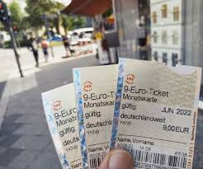
The 9-Euro-Ticket as an instrument to strenghten social participation
Initial situation
Reason for introduction: Relief for private households from increased energy prices/damping inflation
Was available throughout Germany from June 2022 - August 2022 at a price of 9 Euros for all local public transport and regional trains
Effects
Particularly attractive for: young people, low-income earners, urban residents
Significantly strengthened social participation of people with low incomes
Estimated CO2 emissions saved: 205,000t CO2 to 671,840t CO2
But no lasting effect on public transport use
Too short a period of time for a sustainable change in behavior
Lack of public transport options, especially in rural areas
Current status
Germany ticket for 49 EUR; discounted social tickets in some regions
Expansion of public transport necessary
Financing of the Germany Ticket open from 2024
Notes:
Studie zu Wirkungen des 9-Euro Tickets von Agora Verkehrswende: https://www.agora-verkehrswende.de/fileadmin/Veranstaltungen/2022/9Euro-Ticket/RWI_Andor_Webinar_Agora_Verkehrswende_9_Euro_Ticket.pdf
Studie zu 9-Euro-Ticket vom DIW:
Studie zu 9-Euro-Ticket von Institut Verkehr und Raum der FH Erfurt: https://idw-online.de/de/news803408

Slide 12
Infrastructure expansion as part of public services
Promoting energy-efficient social housing
Expansion of public transport infrastructure, especially in rural areas
Municipal heat supply/expansion of district heating networks
Shaping neighborhood development in a social and sustainable manner
Broad-based participation processes to ensure needs-based planning
Notes:
: Parks/ Grünflächen für Stadtklima und als Teil des Sozialraums

Slide 13
What can we do?
Political Advocacy Work
Affordable public transportation
  Does not just support lower CO2-emissions in the transport sector, it also increases the options for particiation and mobility for groups that do not own a car/ cannot drive
Increasing the energy efficincy of housing especially of low-income groups
  Does not only benefit climate protection, but also helps fight energy poverty
Energy efficiency programs/ funding programs for energy saving devices
Providing support locally
Offering energy efficiency advice
Provide heat relief/ access to water
  Increasingly, not only access to warm spaces in the winter will become a necessity in northern Europe, but cool spaces and water access during heat waves in the summer as well

Slide 14
Thank you!
Anna-Lena Guske
Sozial-ökologische Transformation
anna-lena.guske@diakonie.de
Zentrum Soziales und Beteiligung
Diakonie Deutschland

