Slide 1

Artificial Intelligence, Digitalisation, and Social Services: Ethical Challenges
Eurodiaconia Annual General Meeting, 16 May 2024

Slide 2

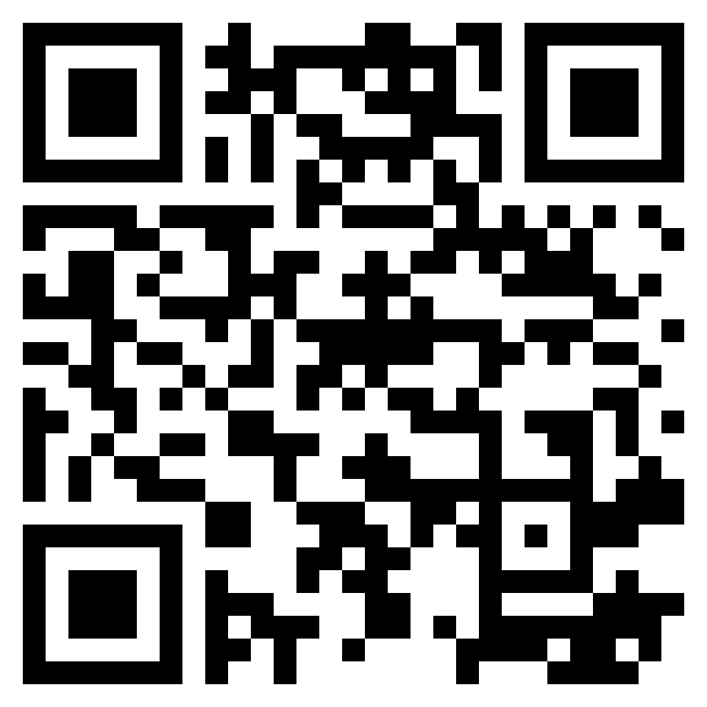
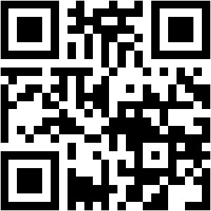
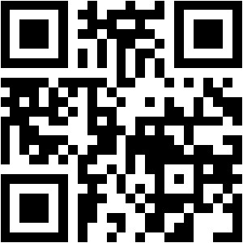

Are you a digital justice champion?
play our game!
jouez le jeu !
¡juega!
spielen Sie das Spiel!
Notes:
WACC = World Association for Christian Communication
It was founded in 1968 but had predecessor associations of Christian communicators, especially Christian radio and television broadcasters who – especially from the experience of World War II and nationalist movements were highly concerned by the use of mass media – at that time television, radio, film, newspapers – for propaganda.
WACC strengthened the concept that mass media should serve the public good. In place of government control and commercial interests, those responsible for the mass media should be the voices of democratic accountability, balanced news and cultural diversity.
As communication technologies have rapidly evolved, the fundamental ethical- and rights - principles have remained

Slide 3
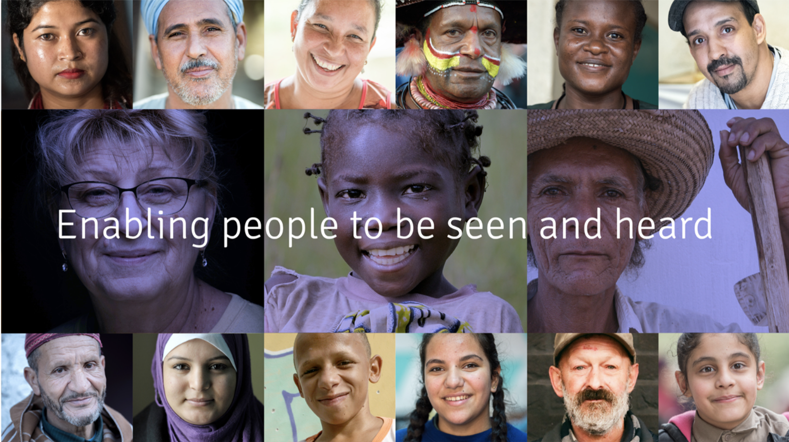

Notes:
I was delighted to see the theme of this annual general meeting as it feels exactly what WACC aims to do. We believe that unless people can be seen and heard they cannot participate fully in society and democratic processes, with associated impacts on sustainable development.

Slide 4
WACC is an international development organization that promotes communication as a basic human right, one that is essential to people’s dignity and sense of community.
Rooted in the Christian faith,
WACC works with all those denied
the right to communicate because of status, identity, or gender.
Notes:
WACC = World Association for Christian Communication
It was founded in 1968 but had predecessor associations of Christian communicators, especially Christian radio and television broadcasters who – especially from the experience of World War II and nationalist movements were highly concerned by the use of mass media – at that time television, radio, film, newspapers – for propaganda.
WACC strengthened the concept that mass media should serve the public good. In place of government control and commercial interests, those responsible for the mass media should be the voices of democratic accountability, balanced news and cultural diversity.
As communication technologies have rapidly evolved, the fundamental ethical- and rights - principles have remained

Slide 5
Right to Privacy
Freedom to research & access to public information
Language rights, especially one’s Mother tongue
Access to media & technical resources
Freedom of opinion and expression
Freedom of the press
Right to education
Communication Rights
Freedom of thought
Freedom to research & access to public information
Freedom to give and receive information
Access to media & technical resources
Freedom of expression & opinion
Freedom of the press
Citizens critical awareness of information processes
Communication Rights
Notes:
WACC works within a framework of communication rights – While Freedom of Expression is most often and easily recognized as a right – as Article 19 in the universal Declaration - this is only one of the rights expressed in international covenants. And what is more, and significant for addressing digital transformation, communication rights need to be seen in relationship to each other.
Communication rights enable all people everywhere to express themselves individually and collectively by all means of communication. For WACC, communication rights lies at the heart of greater social justice and good governance, whose key attributes are transparency, responsibility, accountability, participation and responsiveness to the needs of the people.
Question for today – how does this apply to our digital platforms and services – and what do we need to take into account?

Slide 6

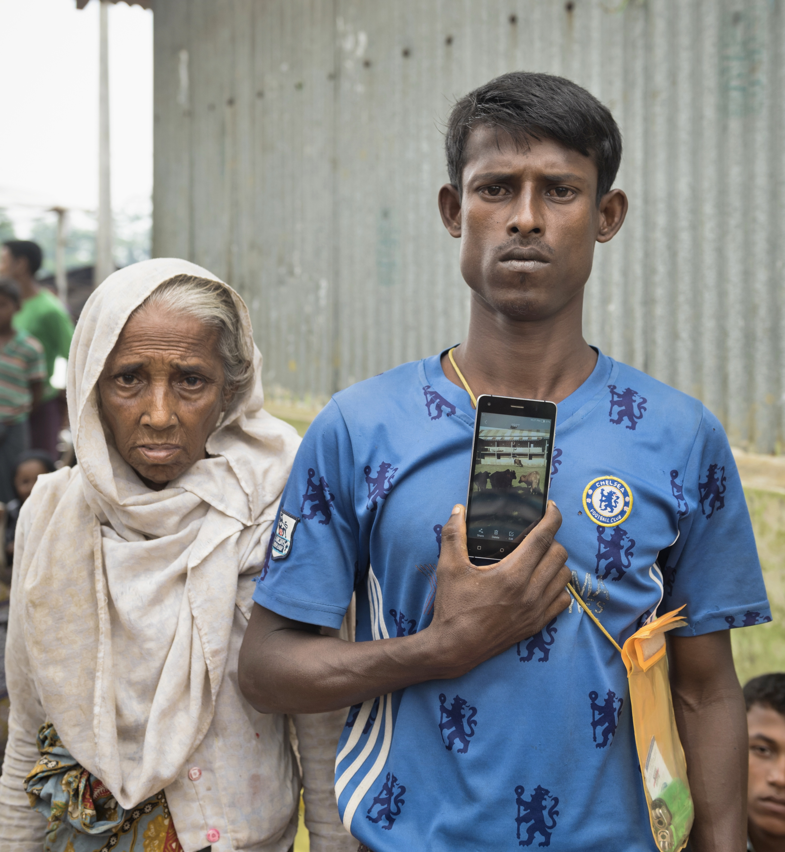
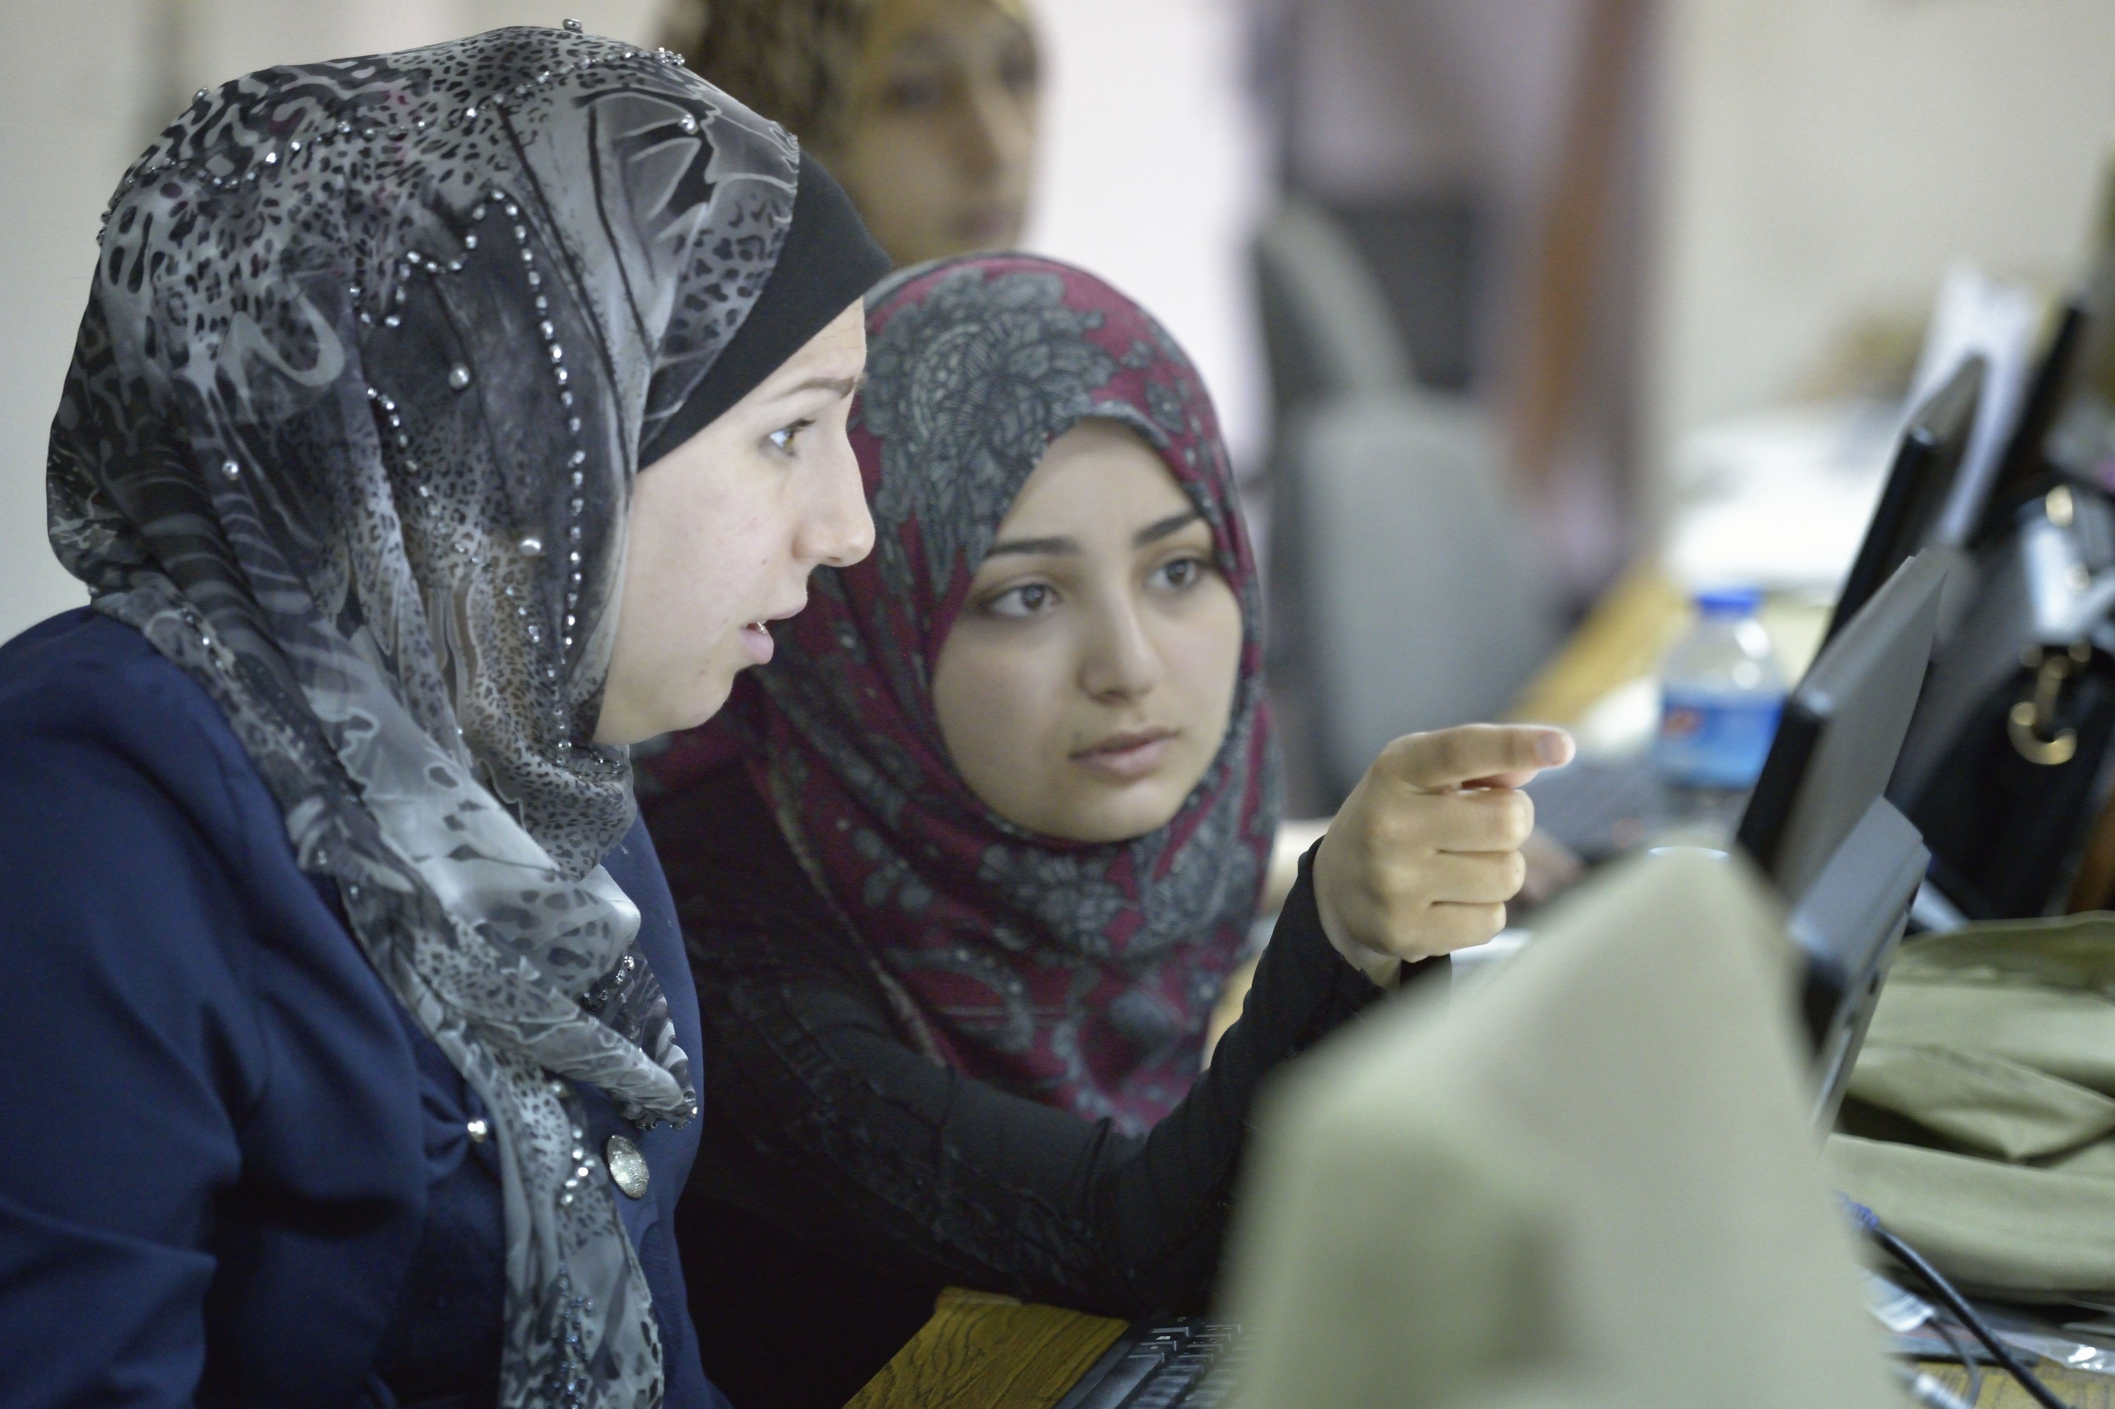
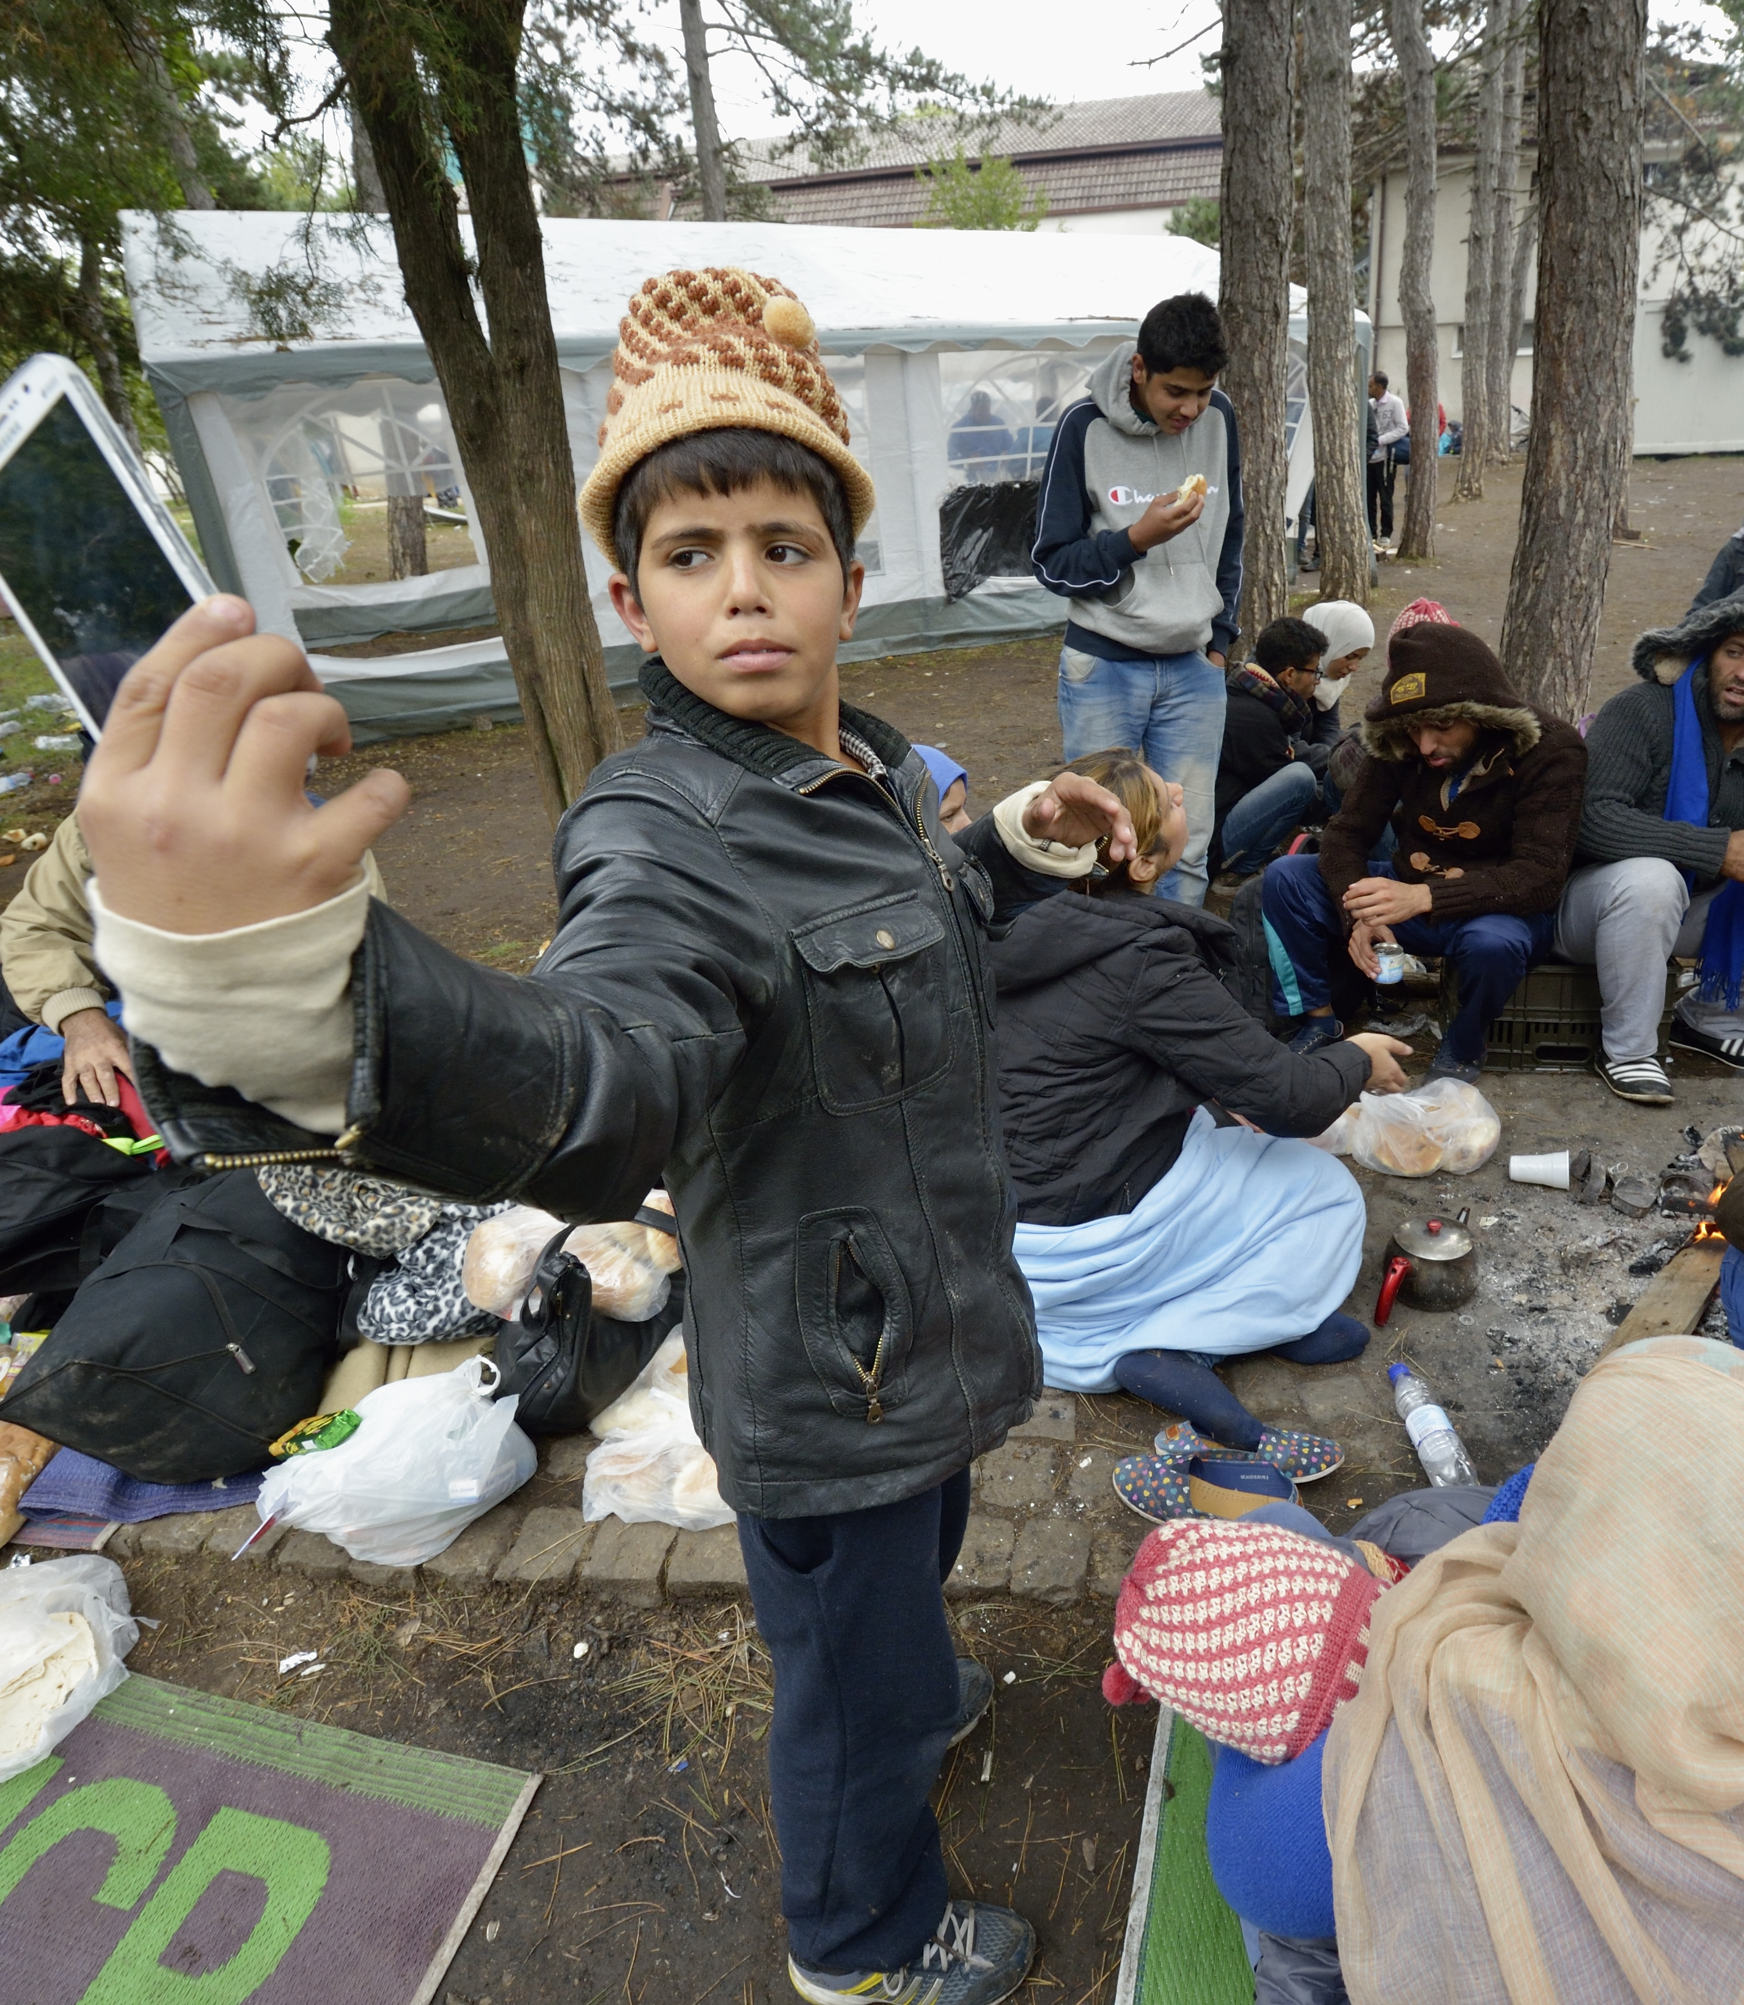
Potential of the digital age?
Photos: Paul Jeffrey (2) and Joel Carillet/ACT Alliance
Notes:
What is our gut feeling about the increasingly vast implications of the digital transformation? Do we see first the potential for previously marginalized people and communities having a voice, exposing injustice, empowered by information?

Slide 7



5.44 billion internet users
5.07 billion social media users
About 2 billion websites
Over 8.5 billion Google searches daily
Artificial intelligence is more embedded than most think.
Notes:
Or do we find the digital transformation increasingly intrusive and taking over every aspect of our lives, ruled by a few incredibly powerful tech giants, destabilizing democratic society and capitalizing on increasing stores of data to modify our political and consumer behavior?
The reality of course is something in between.

Slide 8
Principles
Accessibility
Affordability
Equality/equity
Diversity
Participation
Connectedness
Accountability
Transparency
Notes:
Essential principles we need to apply in our reflection and response – especially in our use of digital technology and communication. If these principles are followed, we have a positive, inclusive, just society.
We see many of the same behaviours and realities we see offline, are replicated and sometimes magnified online.
The digital world is massively influencing all parts of our lives and relationships.
What are human rights off line should be human rights online,
Critical to move beyond issue of access to address structural and social justice concerns such as ownership and regulation – and what that means for those of us delivering services to vulnerable populations.
What challenges do you already see that prevent us from meeting these principles?

Slide 9
Challenges
Ownership and control
Misinformation / Disinformation
Data harvesting and privacy
Hate speech and microagressions
Racial and gender bias
Environmental impact
Algorithmic bias
Notes:
What challenges do you already see?
(disinformation – data poisoning in AI) – free services will often mean that they collect your data. There are privacy issues – for instance, if you put someone’s CV into an AI language translator, it may collect what you have put in as an additional text to continue tto train its model.
The other issue is that it uses your data in its commercial model

Slide 10
What should we do about….
Using gen AI to
generate a photo for a story
Translate a paper
Summarize a document
Write a report
Help assess job or service applications
Notes:
How do we navigate the challenges and maximize the potential?
Digital and AI are here, they will become more prevalent, we need to know how to operate in this landscape and support resilient communities.
We need Guidelines for our own organisation
We need to incorporate proactive digital methods:
digital media literacy
foster a community of trust
be a community of trust

Slide 11
A vision of digital justice
“The issue of digital justice relates to the whole range of issues of concern to the ecumenical fellowship. The increasing militarization of digital technology and artificial intelligence, its use in surveillance and censorship, and the deliberate destabilizing disinformation tactics impact our public witness.
The power and wealth concentrated in a few technological organizations, and the ecological impact of mining for the resources needed to meet the increasing demand of digital devices has clear implications for sustainability and the economy of life.
The gender gap in digital access, biased algorithms, and online abuse and violence against women affect our efforts towards a Just Community of Women and Men. And rapid developments and the use of artificial intelligence impact areas of health, race, and what it means to be human.
While addressing the challenges, we have the opportunity to identify and model digital justice in education, mission and evangelism, and work in human rights as well with international organizations and interfaith partners on the path of justice and peace.
A New Communications Paper for the 21st Century (World Council of Churches, 2022; based on the Manifesto of the International Symposium, Communication for Social Justice in a Digital Age.
Notes:
How do we model digital justice?
Personal and organizational guidelines
Be informed
Foster a community oof trust and digital resilience

Slide 12

Develop Guidelines for your Organization
Be respectful of the people you serve, of copyright, of professional creators
Be transparent and credit your sources
Be truthful in your messages
Be wise in the use of your tools

Slide 13
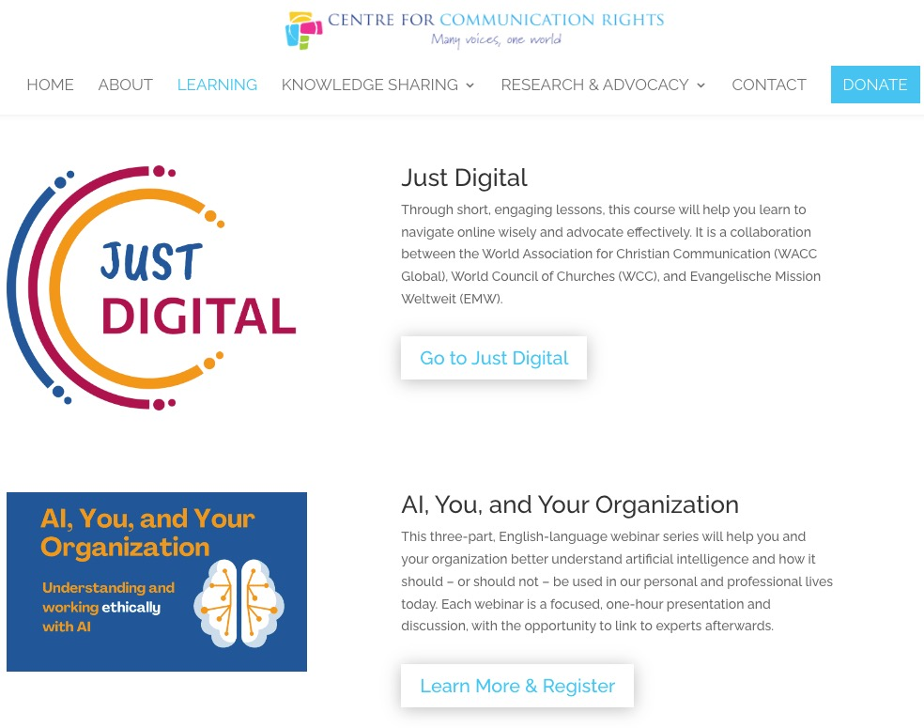
Be informed
https://ccrvoices.org/courses/ai-and-you/
For info on learning opportunities and resources: ss@waccglobal.org

Slide 14
Foster a Community of Trust and Digital Resilience
Be proactive:
Incorporate digital media literacy in your services
Help identify digital and information needs in your community and help to resolve them
Know how to identify misinformation/disinformation and help your community to do the same.
Education – Community – Action
www.waccglobal.org
Notes:
[gender cyberviolence – social media monitoring

Slide 15
final thoughts
that we should stop thinking that digital technology was ‘good’ or ‘bad’ in itself but recognise that it creates opportunities and threats whose impact can be positive or negative (or both);
that we should consider in advance how we want innovations to change our lives rather than letting technology take those decisions for us;
that we should recognise we, in our communities and our societies, have the right to shape the Information Society, and that we need to exercise that right if we want it to respect human rights, protect the environment, enable sustainable development, promote diversity, limit capacity for conflict, and achieve greater equality;
Inside the Digital Society: How optimistic are you? David Souter, https://www.apc.org/en/blog/inside-digital-society-how-optimistic-are-you-0

Slide 16
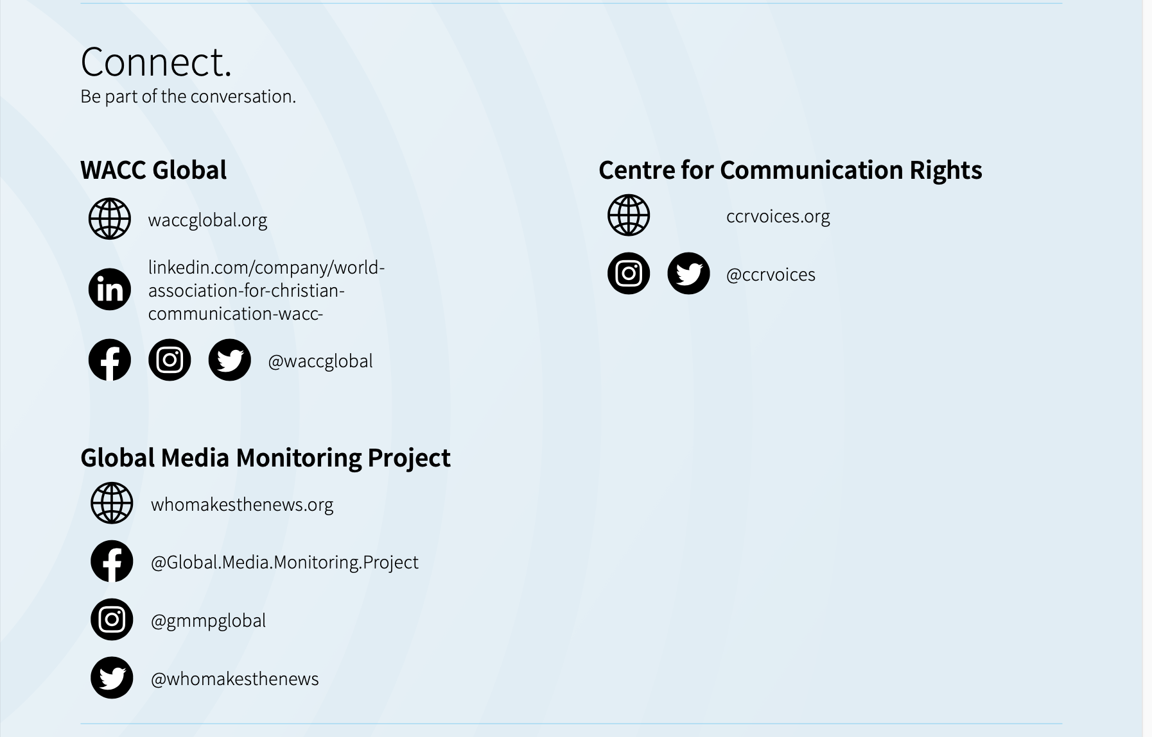

Email
Sara Speicher: ss@waccglobal.org

