Slide 1
Evangelical Diakonia in Slovakia

Slide 2
SOCIAL-DIAKONIC WORK
DISTRIBUTION OF HUMANITARIAN SUPPORT, EMERGENCY SHELTER, HYGIENICKITSAND FOOD
DELIVERED PSYCHOLOGICAL SUPPORT IN GROUP TO INDIVIDUAL CONSULTATIONS FOR KIDS AND TEENAGERS
PREVENTION FOR DIFFERENT SOCIAL GROUPS AND EDUCATION AND VOLUNTEERING
INDIVIDUAL ASSISTANCES AND HEALTH AND LIFE SITUATION CONSULTATIONS
COMMUNITY MOTIVATION EVENTS

Slide 3
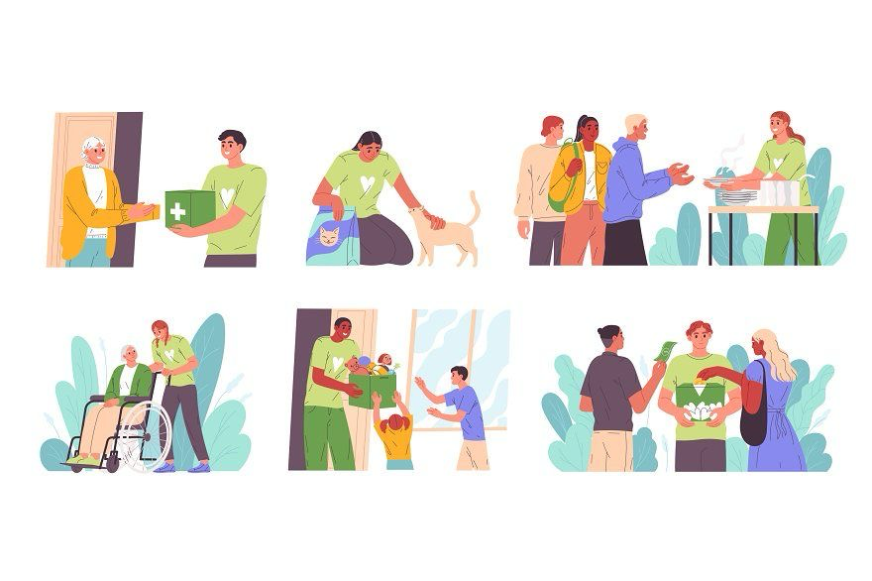
TARGET GROUP
PEOPLE IN NEED OF HELP
SENIORS
PEOPLE WITH DISABILITIES
PEOPLE IN VARIOUS DIFFICULT SOCIAL AND HEALTH SITUATIONS RESULTING FROM NATURAL DISASTERS AND WAR CONFLICTS

Slide 4
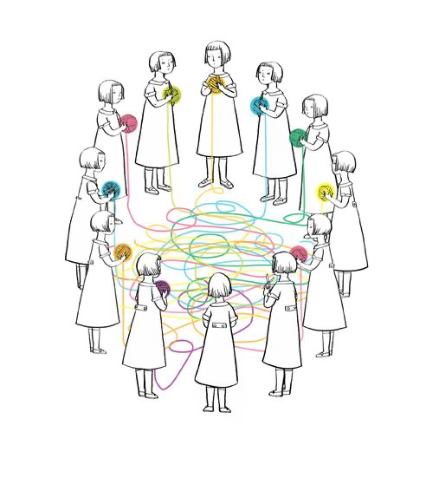
ADAPTATION AND STABILISATION OF REFUGEE FAMILIES
PROBLEM:
New environment
Housing issues
Basic material needs
Different traditions
Public services
Healthcare and individual assistance in 15 communities
Food and material aid cash vouchers distributed to 3200 persons
Housing policy
Installed health support equipment

Slide 5
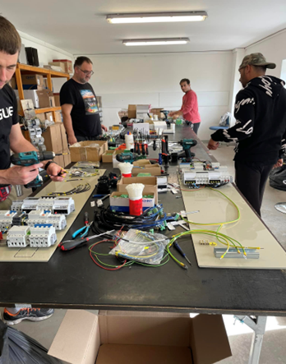
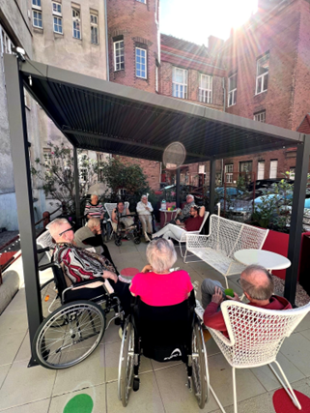
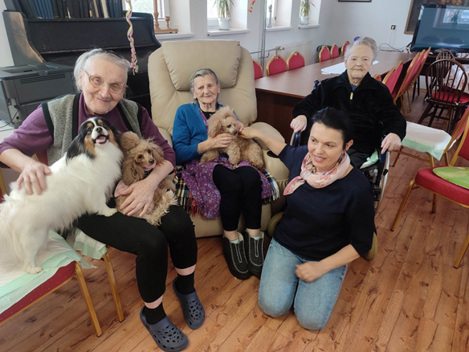
STABILISATION AND SUPPORT
Old people are not employed
Pensioners are living in the collective centres
Psychological stress and trauma
Lack of interactions
Lack of physical and mental support activities

Slide 6
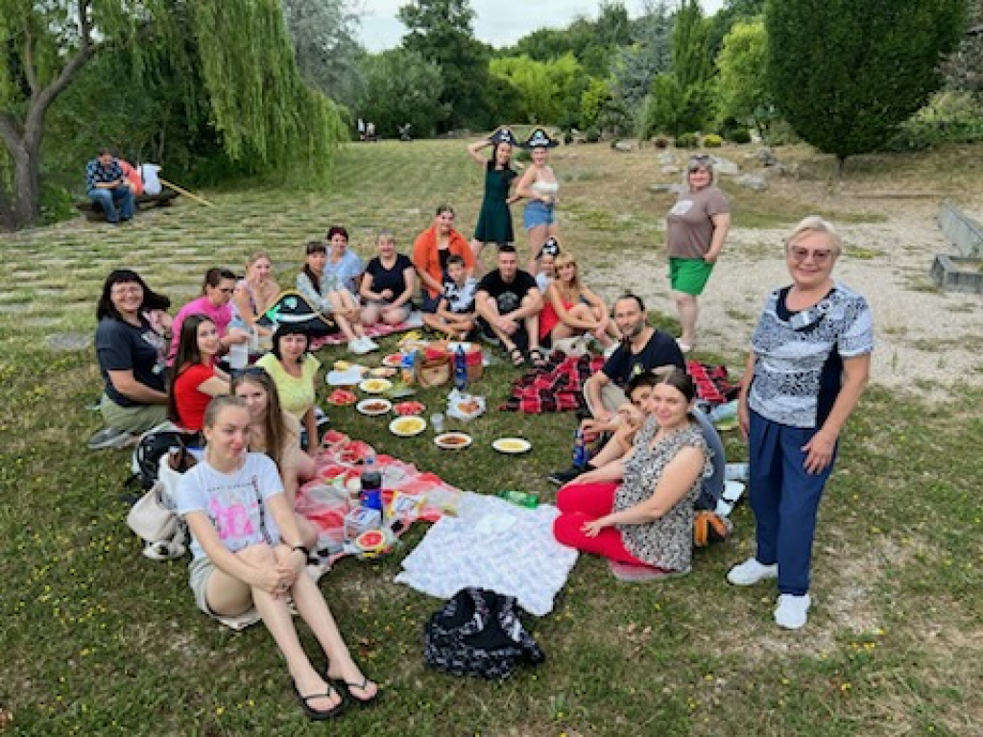
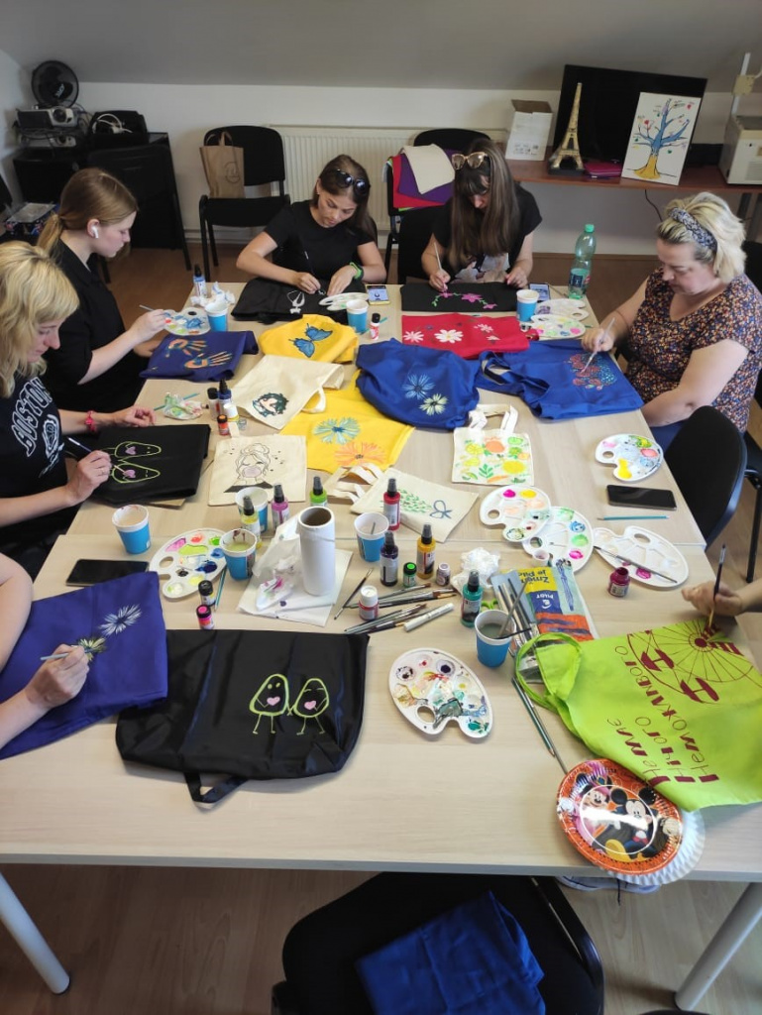
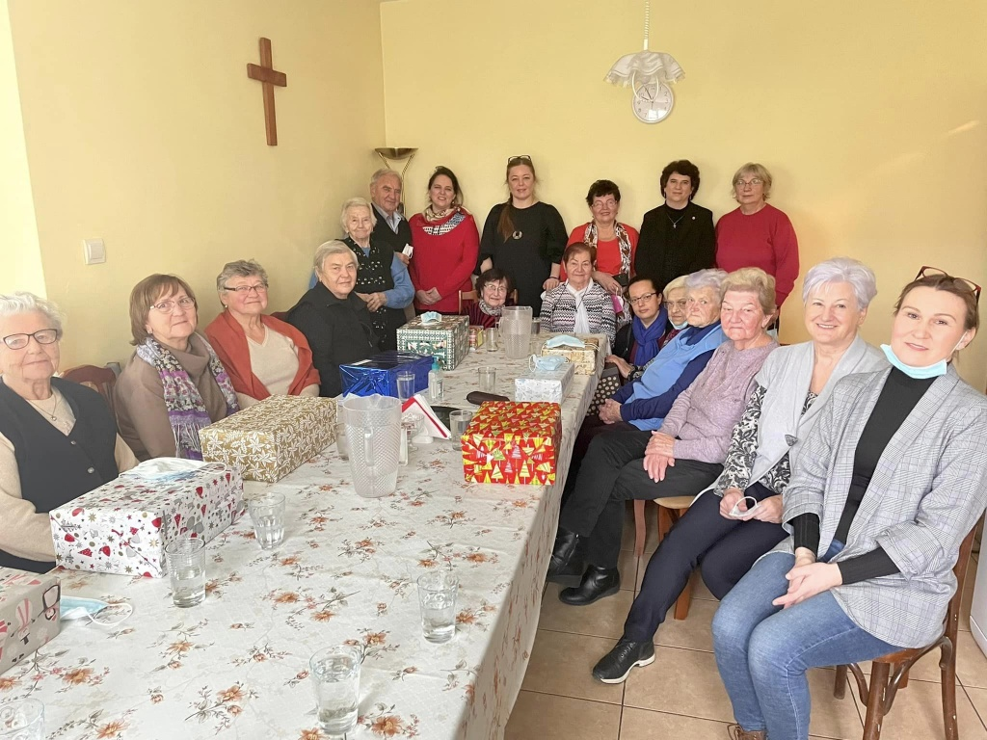
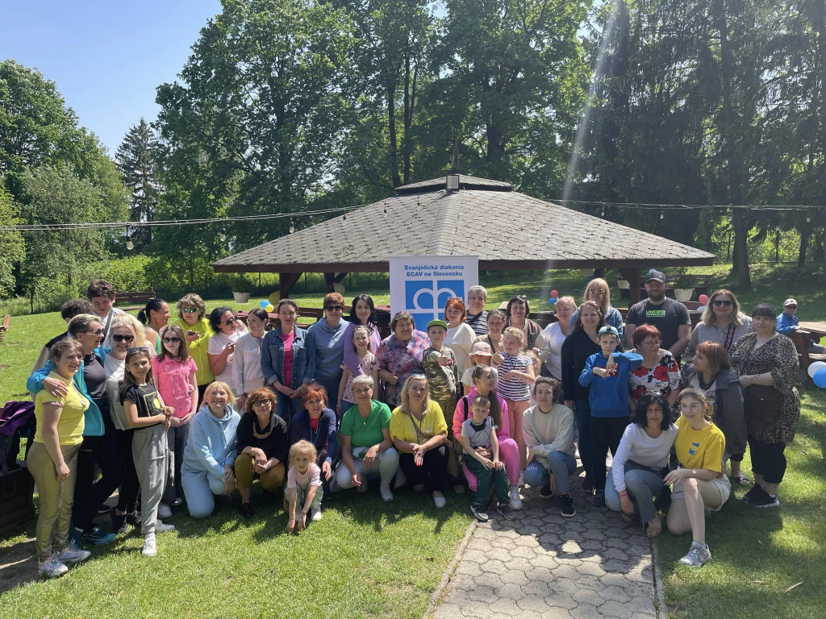
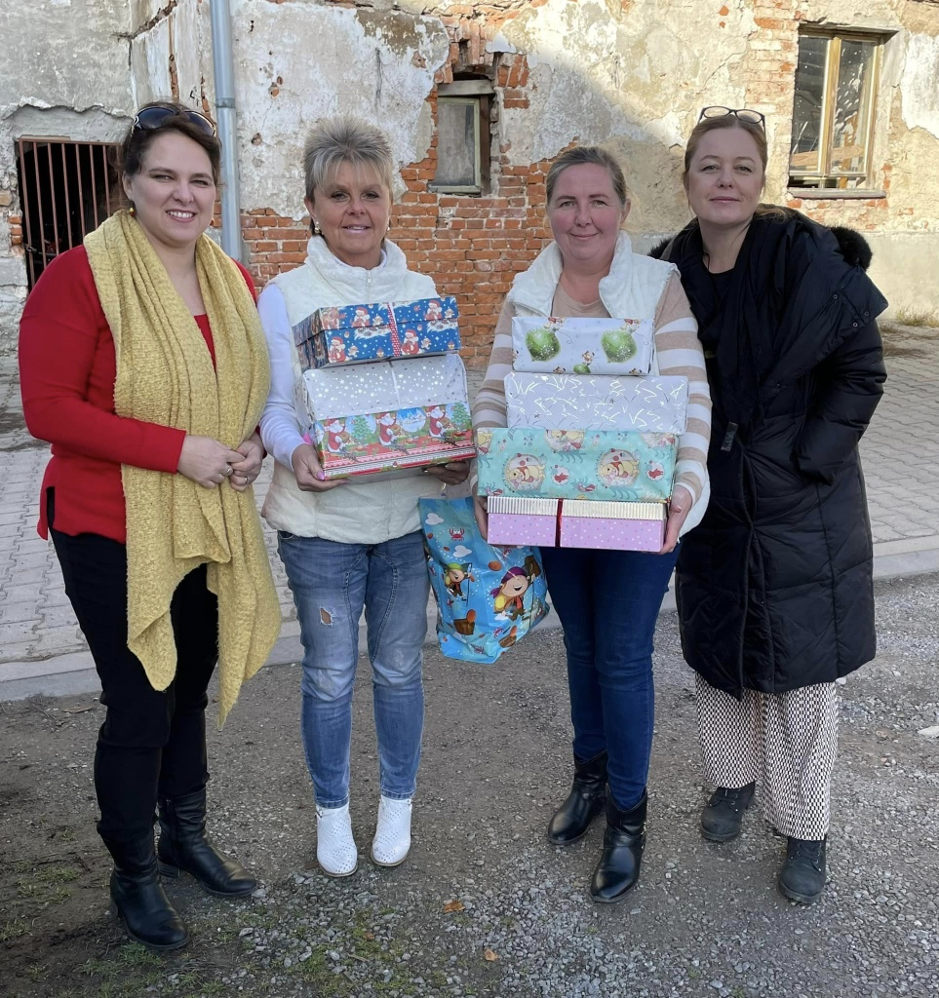
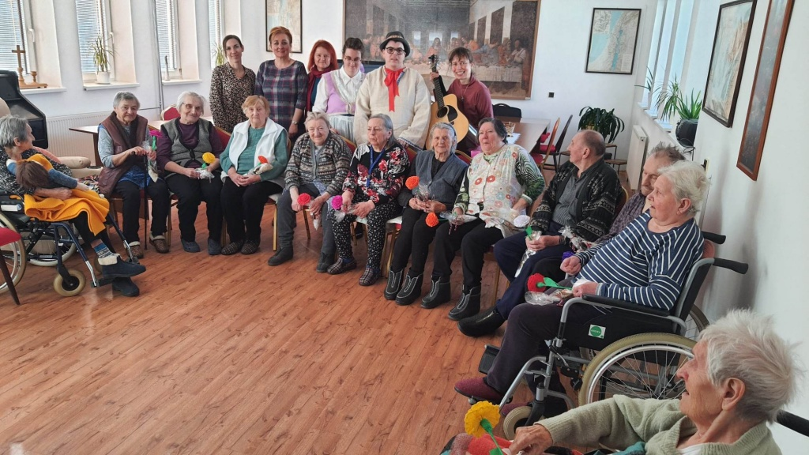
SOCIAL AND HEALTH CARE FORMOST VULNERABLE
GROUPS
Healthcare and individual assistance
Food aid for community activity
Mental and physical activities for pensioners and handicapped persons
Awareness community event of host and refugee pensioners
MOTIVATION AND PERSONAL DEVELOPMENT
Motivation meetings and courses for women
Art therapy and sports activities for adults
Individual consultations

Slide 7
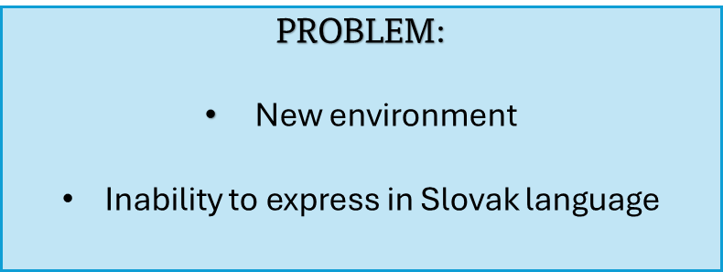
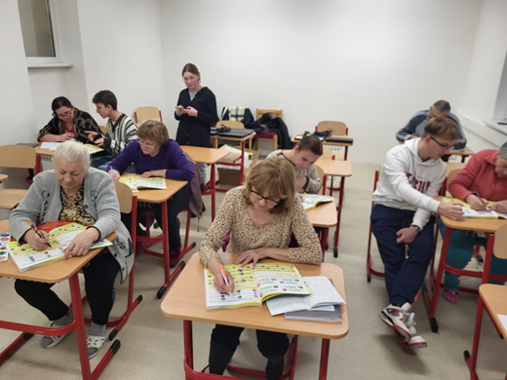
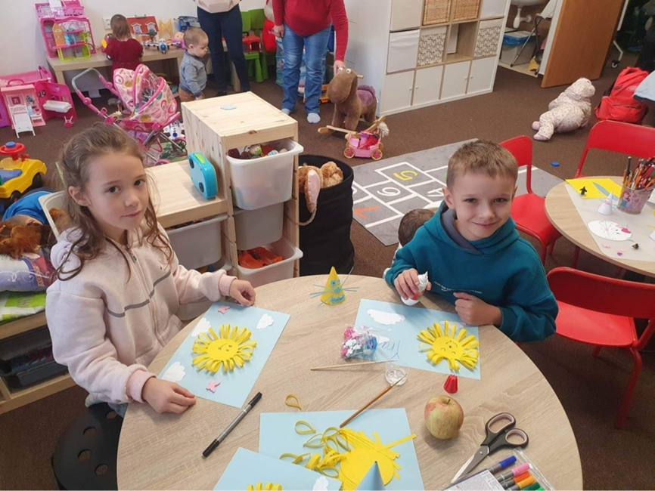
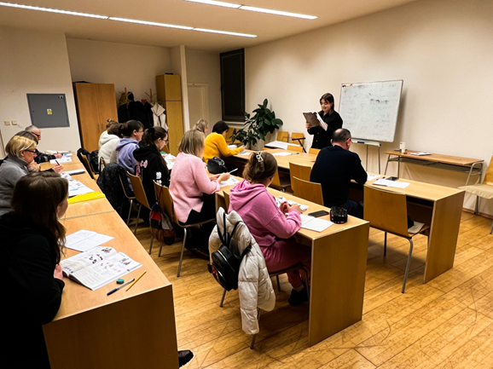
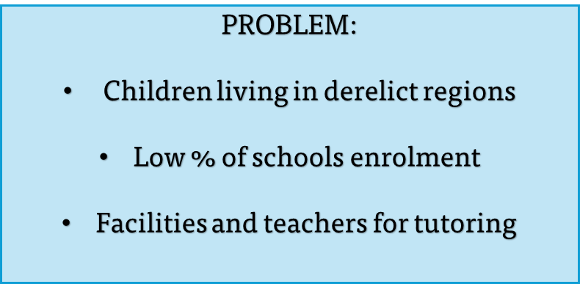

Slide 8
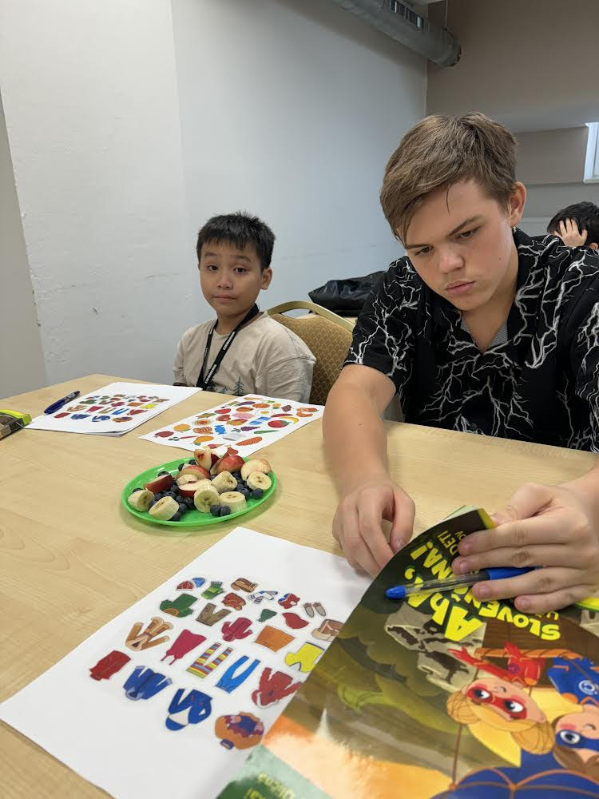
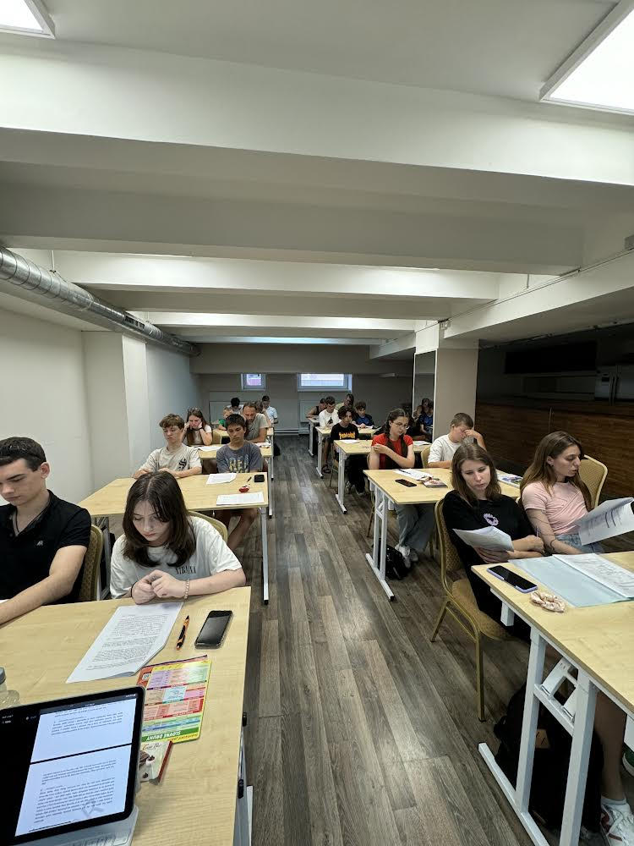
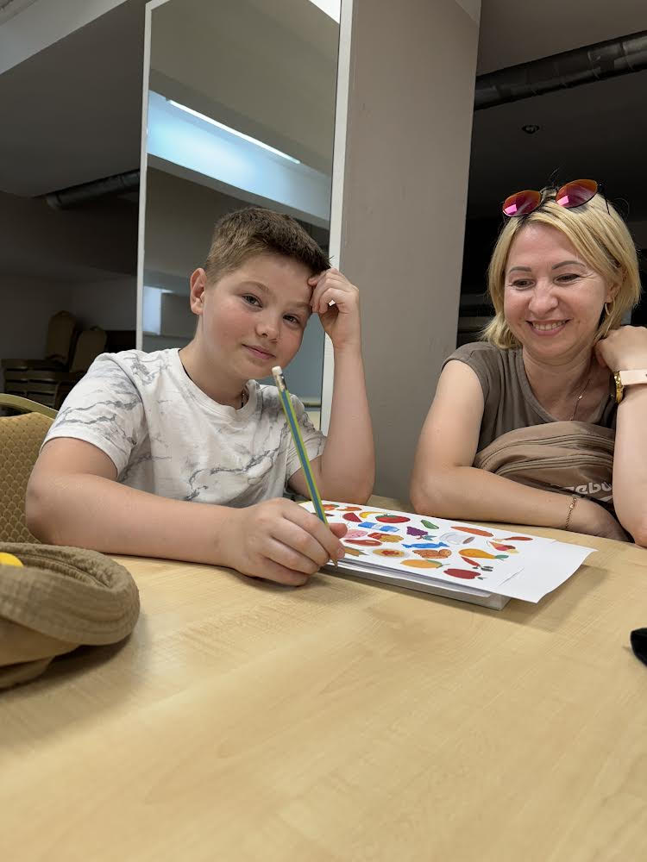
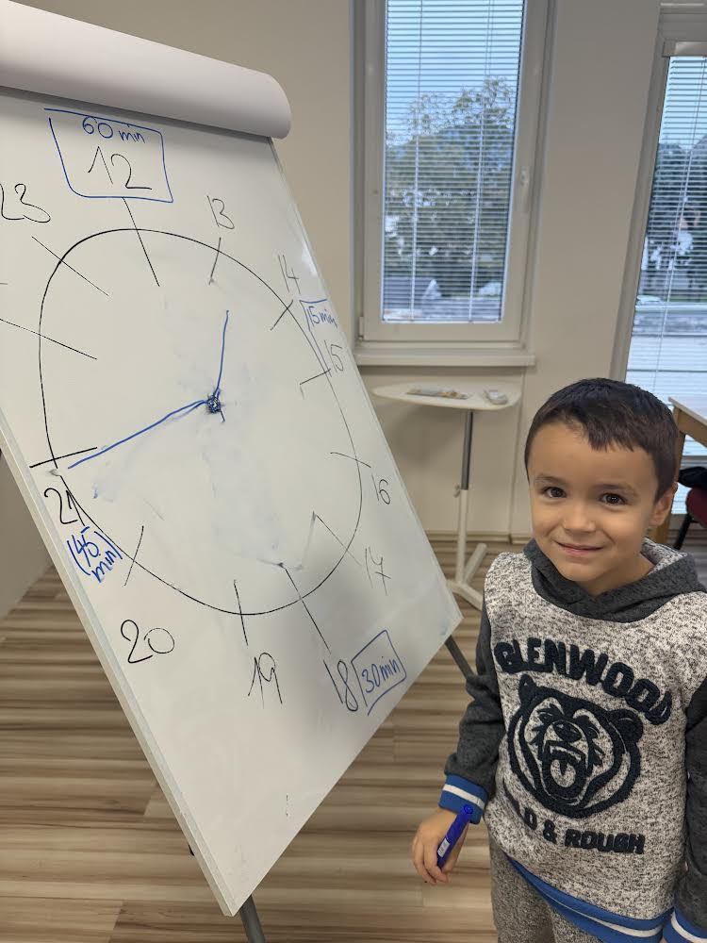
LANGUAGE BRINGS US CLOSER TOGETHER
Continuation and extension of the already 2 years
Improving the Slovak language
Master it in words and writing as a skill
Learn what their knowledge of Slovak brings them in everyday life, in relationships, in learning and at work

Slide 9
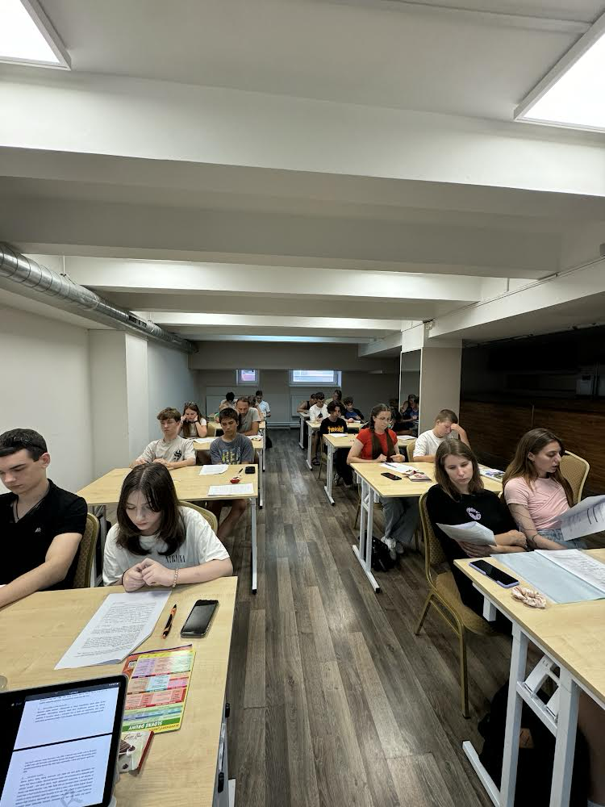
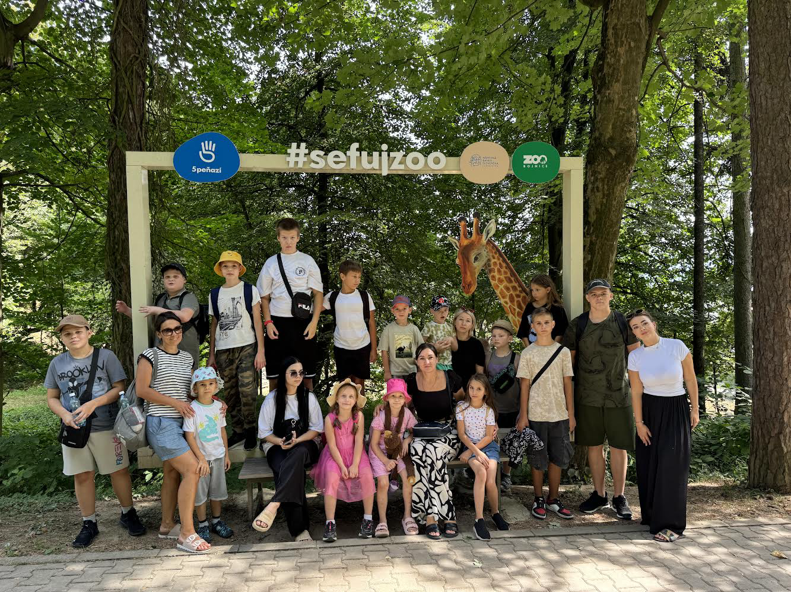
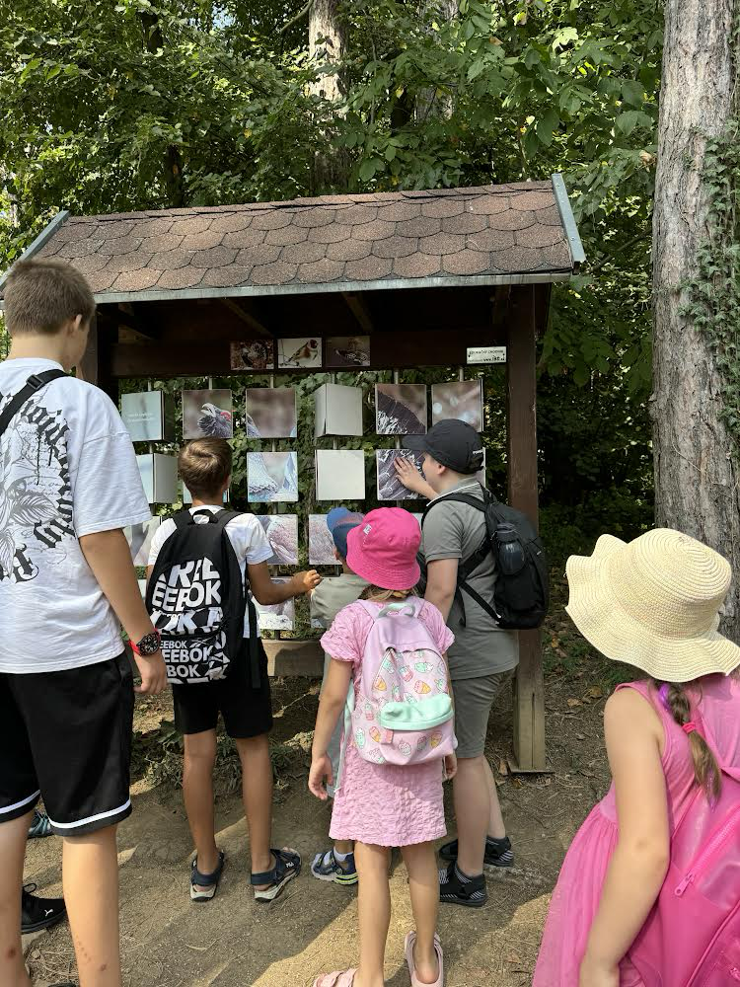
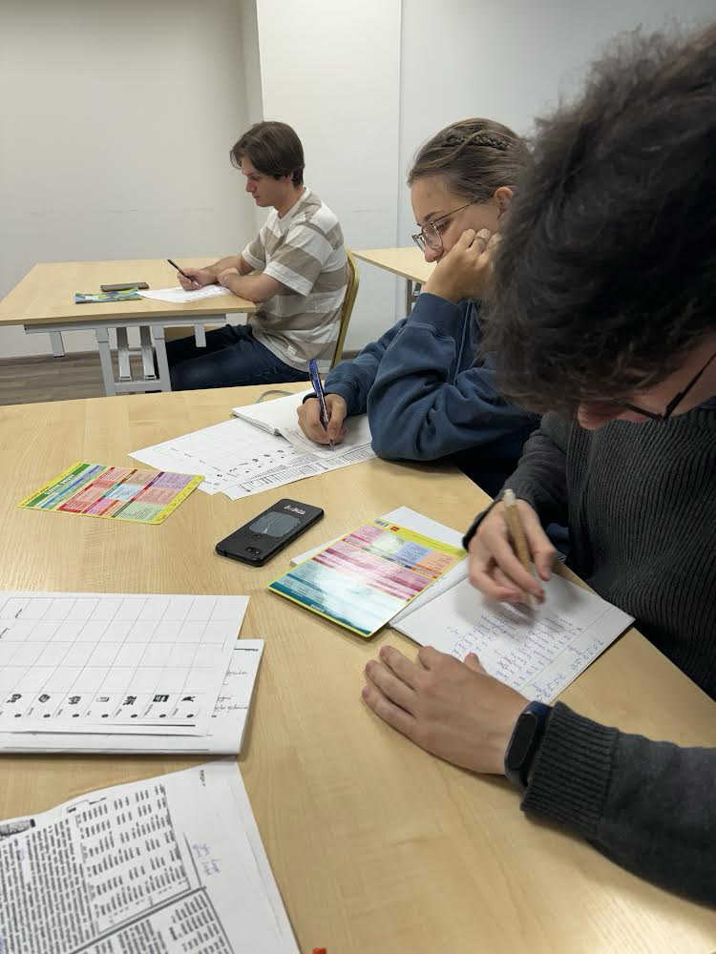
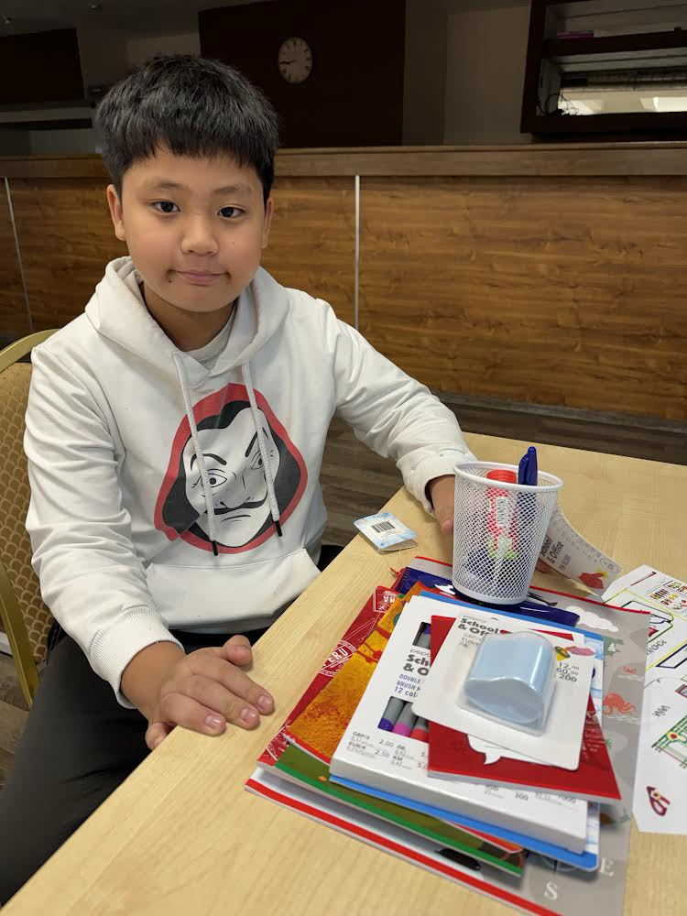
Language support
Preparing children for school, school admissions interviews
Social integration
Joint meetings and study tours

Slide 10
