Slide 1
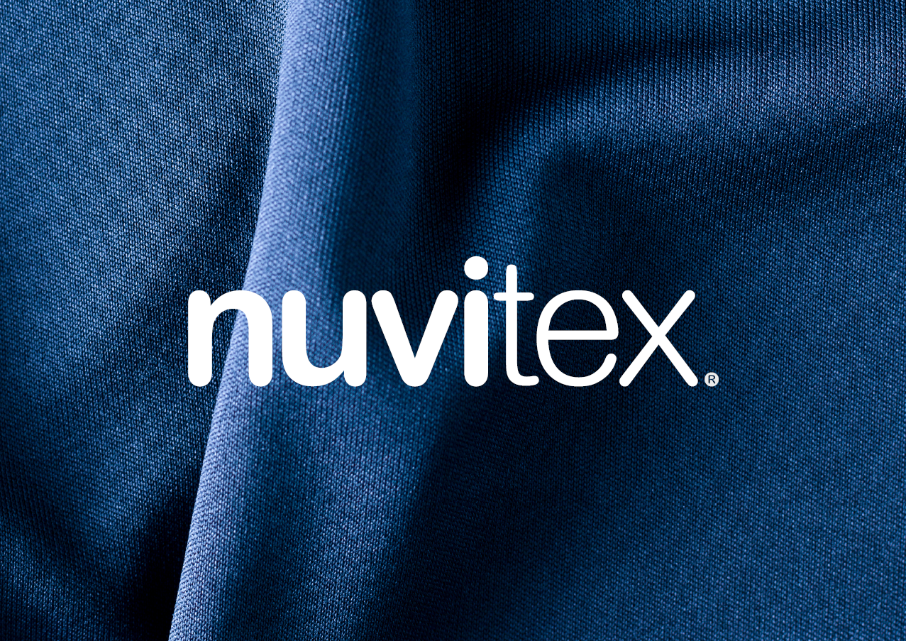
Eurodiaconia Annual General Meeting Athens, Greece
NUVITEX and Real Racing Club de Santander
Partnerships with economic, social, and environmental impact at the local level.

Slide 2
NUVITEX
|Public-Private Partnerships
NUVITEX is a social and business project that facilitates the labor inclusion of people at risk of social exclusion, creating real job opportunities through training and professionalization in the textile sector.
NUVITEX was founded by the NUEVA VIDA association.
Since its beginning in 2021, this initiative has been conceived as a public-private collaboration between businesses, public administration, and the social sector.

Slide 4
NUVITEX
|Responsible Business
In 2024, NUVITEX has become a comprehensive textile manufacturing service that designs, tailors, and produces high-quality garments tailored to each client’s specific needs.
But, above all, NUVITEX has quickly established a local and responsible business model that has successfully positioned social impact as a key objective for companies.

Slide 5
|Corporate Social Responsibility
As a result, NUVITEX has built an expanding network of partners who support social and environmental impact initiatives, like NUVITEX, through CSR.

Slide 6
BERRIS
Along the way, NUVITEX created its own clothing brand.
Berris. Fashion with Purpose.
Berris is Fashion.
Berris is Social Commitment.
Berris is Environmental Commitment.

Slide 7
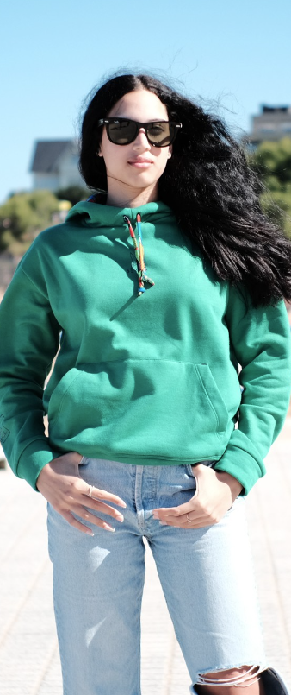
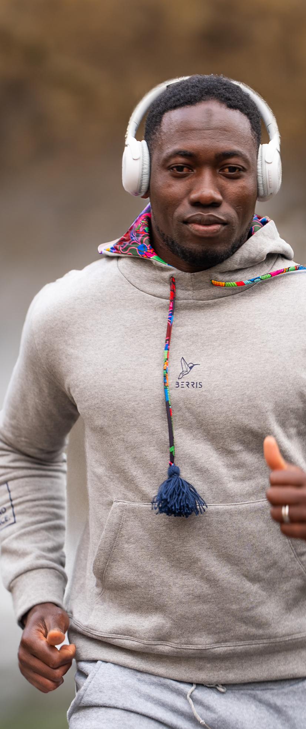
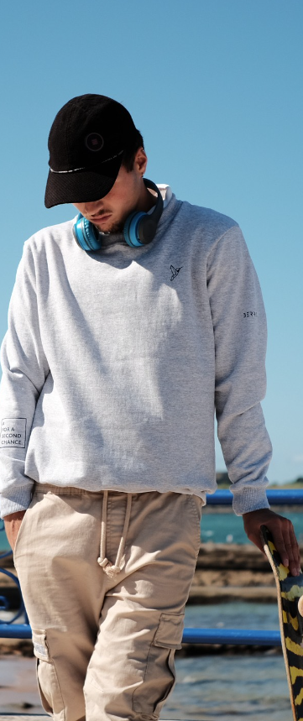

Slide 8
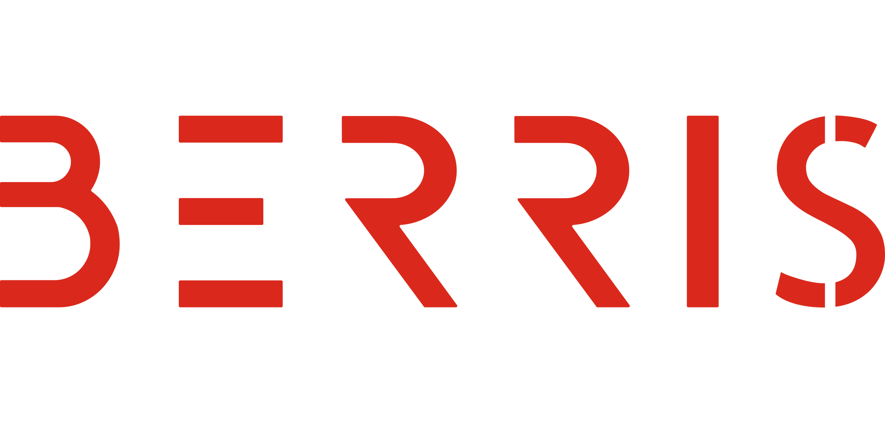
BERRIS
|Fashion with Purpose

Slide 9
RACING
|’Mujer Global’ Project
Real Racing Football Club got in touch with us, proposing a collaboration.
Two main objectives:
Support vulnerable individuals and groups by promoting their inclusion in sports, specifically through football.
Raise awareness about social exclusion and the many faces of vulnerability through football and the region’s main football club.

Slide 10
RACING
|’Mujer Global’ Project
What is ‘MUJER GLOBAL’?
Held once a week for five months.
10-12 women, participants of various Nueva Vida programs (international protection, the prison system, homelessness, and sexual exploitation).

Slide 11
RACING
|Proyecto ’Mujer Global’
What is ‘MUJER GLOBAL’?
1 hour of training + ½ hour of psychological support focused on strengthening social skills (teamwork, frustration management, leadership, trust, discipline, self-esteem, vision, perseverance, etc.).
Includes minor children (participants’ children), who attend the Racing school and join the youth teams.

Slide 12
RACING
|another step forward
As a result of this first collaboration, Real Racing Club de Santander wants to go further.
We want to collaborate again!
We want to take another step forward!
We want to create a joint project!
Let’s do it!

Slide 13
RACING
|Official Equipment
Collaboration between Real Racing Club de Santander, Austral Sport, and NUVITEX.
Phase 1 of the collaboration: The Anthem Jacket! A garment that is part of the team's official kit.
But this is not an ordinary jacket—it is a joint project against GENDER VIOLENCE.
In the context of the International Day for the Elimination of Violence Against Women, on November 25, the new anthem jacket will be launched.

Slide 14
RACING
|Official Equipment
Triple Alliance:
AUSTRAL SPORT: designs the jacket together with NUEVA VIDA ASSOCIATION;
NUVITEX: produces the jacket;
RACING: includes the jacket as part of the official kit and sells it.
This joint project not only helps raise awareness and fight against gender violence but also contributes to NUVITEX's economic sustainability.

Slide 15
RACING
|Official Equipment
Collaboration between Real Racing Club de Santander, Austral Sport, and NUVITEX.
Phase 2 of the collaboration: Casual clothing line.
Currently under development…
We want to take another step forward!
Let’s do it!

Slide 16
Eurodiaconia Annual General Meeting Athens, Greece
NUVITEX and Real Racing Club de Santander
Partnerships with economic, social, and environmental impact at the local level.

