Slide 1
Translated from Spanish to English - www.onlinedoctranslator.com
www.diaconia.es/proyecto-contigo-diaconia-acnur/
Project with you
Voluntunteering with young refugees

Slide 2
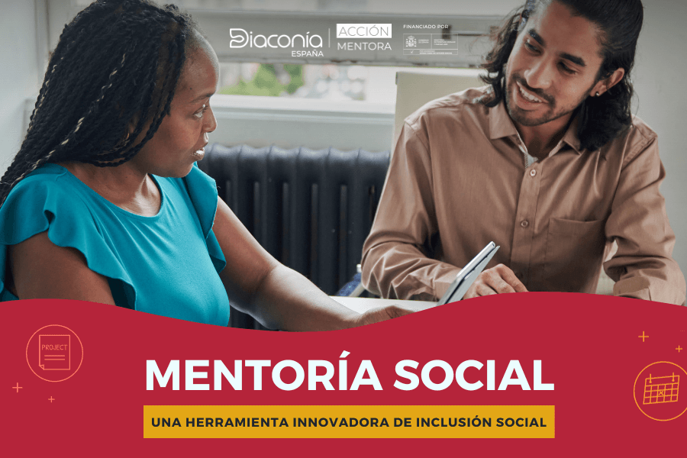
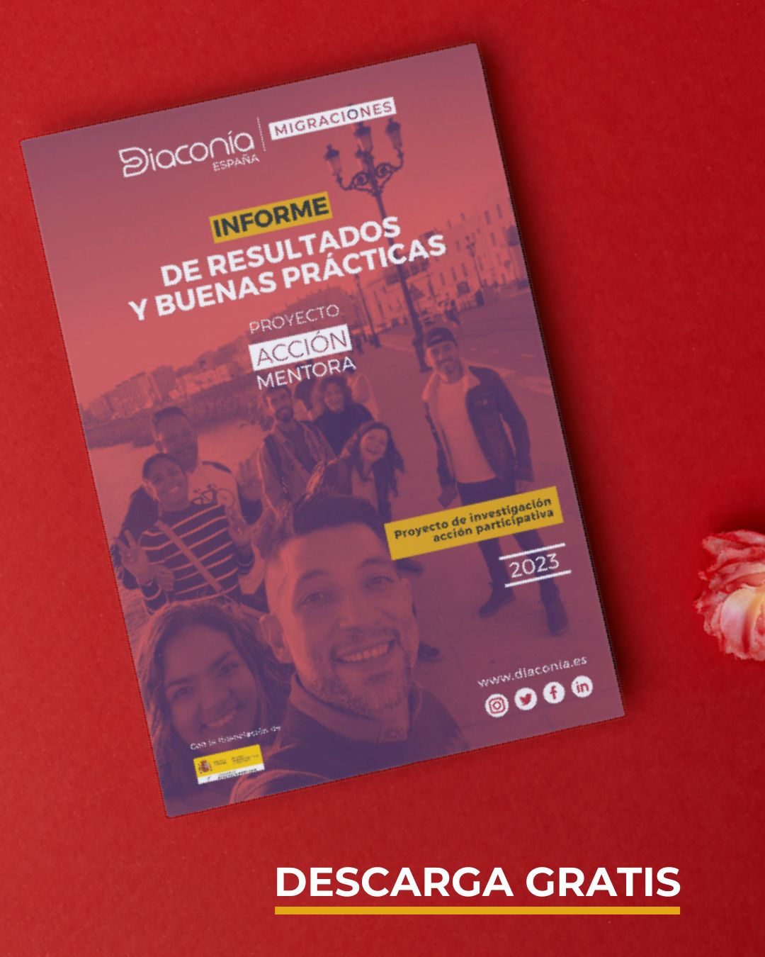
Background
“Mentor Action”

Slide 3
Goals
1
2
Creation and support of social networks for young refugees.
Access to leisure and promotion of social participation of refugees.
Promote sensitivity and involvement of companies and universities on the reality of refugee children and youth and their process of inclusion in society.
3

Slide 4
Project with you
Creation of social networks to support refugee children and youth, through the action and participation of volunteers.
Enriching our society
Leisure
alternative
With the collaboration and support
from UNHCR, Diaconía Spain
starts the Project Contigo, in line with the “Strategic orientations
United Nations Conference on Integration in Europe”.
Support spaces
Social involvement
Natural and horizontal relationships
Diversity
ethnic-cultural

Slide 5
Participants
Beneficiaries of international protection
Volunteers
University graduates and/or active in labor market, aged 16 and over.
Young beneficiaries of IP between 15 and 28 years old
Motivated to carry out activities that promote the inclusion of refugees.
Motivated to do activities accompanied by a volunteer to facilitate their integration

Slide 6
How do we work?
Initial interview to know the profile, interests, motivations and expectations, assess needs and evaluate which people may be the best link.
A first presentation meeting is organized with the technical teams.
If there is affinity and the parties agree, the links/encounters will develop freely, always counting on the monitoring and support from the technical team.​
Periodically information about events in the locations is sent, individual activities are proposed and group activities organized.​
Access to activities is facilitated through financial support.

Slide 7
Technical team
Our function is to link in the best possible way beneficiaries and volunteers.
Supervise the process, organize activities, train mentors and manage relationships, including possible complaints and/or suggestions from all participants.
WORK TEAM
Main tools:
Elaborated interview script
Social monitoring reports
Monitoring of financial aid
Systematization of monitoring links
Messaging group (WhatsApp)
Teamwork:
Plan integration strategy (what) and bond development (how)
Proposal and organization of activities
Incident and conflict management

Slide 8
Activities
Getting to know new cultures
School support
Leisure activities
Support in administrative procedures.
Language practice
Sharing free time
Housing search support
Diversity
ethnic-cultural
Awareness activities

Slide 9
Intercultural food
Ceramic workshop
Self-defense workshop
Dreamcatcher workshop

Slide 10
March 8
Climbing
Excursions

Slide 11
Where are we?
LOCATIONS
MADRID
CADIZ
MALAGA

Slide 12
CADIZ
International protection
Volunteering
29 young people in IP situation
Collaborations
25 volunteers
Main nationalities: Syria, Venezuela, Mali and Ukraine.

Slide 13
MADRID
International protection
Volunteering
49 young people in IP situation
Collaborations
45 volunteers
Main nationalities: Afghanistan, Somalia, Syria and Mali.

Slide 14
MALAGA
International protection
Volunteering
20 young people in IP situation
Collaborations
18 volunteers
Main nationalities: Ukraine, Syria, Venezuela and Mali.

Slide 15
Job placement
MADRID
Inditex Salta III Program
- initiated in April 2024
ACTIVITIES
Selection of applications
Interview preparation
Preparation of documentation
Training for employment
Raising awareness in the company
Work insertion is a pillar of inclusion in the host society
Need for awareness raising in companies
Links established within the workplace that facilitate technical learning and adaptation to the new work context.
5 people inserted
3 women / 2 men
Afghanistan, Ukraine, Palestine and Guinea Conakry.
Position: warehouse operator
LEARNINGS
PARTICIPANTS

Slide 16
Lessons learned and challenges
ENGAGEMENT STRATEGIES
PARTICIPANTS
Transfer and promote dynamics of solidarity, mutual respect, exchange of experiences and horizontality.
Individualized attention and support
Stay motivated: Periodic sending of information on events in the localities; individual activities are proposed; organization of group activities according to majority demand and availability.
The residential and work circumstances of people in IP are constantly changing and it is necessary to adapt and/or change the strategy, as well as their needs and/or expectations.
Work on the bond of trust between the technical team and participants.
Volunteering tips: patience, flexibility, curiosity and empathy before judgment.

Slide 17
MAIN OUTCOMES
Increase language level
long-lasting relationships
couples or links that relate to other
increased periodicity
overcoming shyness
increase support network
Job placement

Slide 18
Thank you for participating!

